Slide 1
Aftermath of the Rebellions of 1837-1838

Slide 2
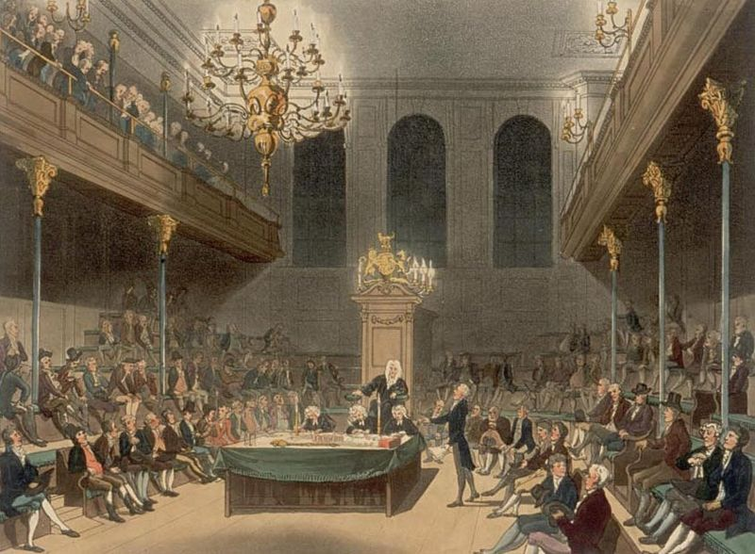
On Feb 10 1838, the British Parliament passed an act suspending the Constitution of 1791 in Lower Canada as of March 27.
The Assembly simply did not sit for three years.
Nor did the Legislative Council.

Slide 3
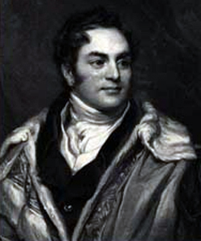
Governor Gosford was empowered to appoint a Special Council of Lower Canada to pass the necessary laws.
He revoked martial law in Montreal.
501 people in the city were in jail for treasonous activities.
Governor Gosford

Slide 4
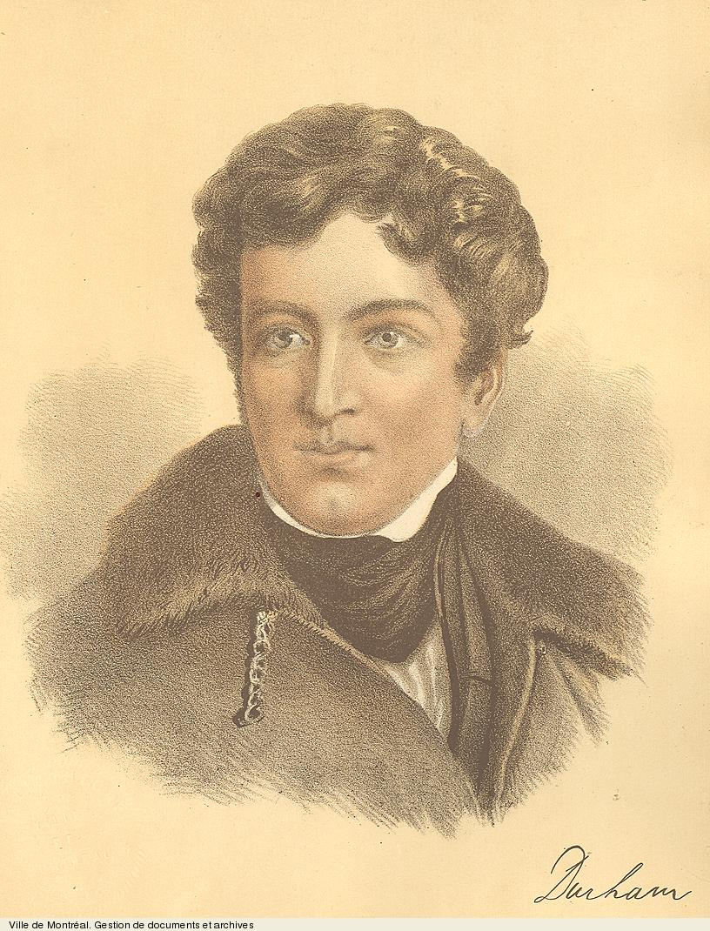
On May 27, 1838, John Lambton, Lord Durham landed at Quebec to replace Gosford.
Lord Durham

Slide 5
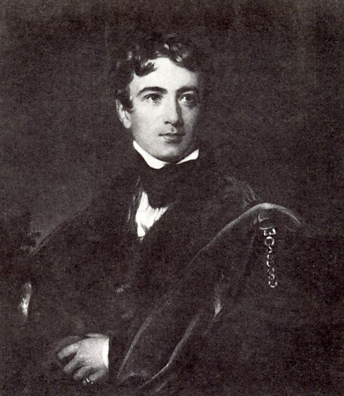
Durham had a mandate
1. To investigate colonial grievances after the rebellions of 1837, and
2. To examine and recommend the form and future government of the provinces of Upper and Lower Canada.

Slide 6
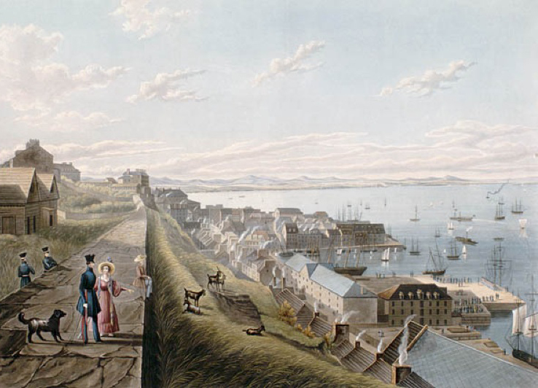
When Lord Durham arrived in the colonies, many Canadians were optimistic. He had earned a reputation as a progressive and forward thinking man who supported responsible government.

Slide 7
Durham quickly set to his task of governing, and began five months of research and travel before writing his famous report.
On June 1, he dismissed the sitting Special Council and appointed his own five-man Executive Council, three of whom he had brought over with him.
He believed that such a move would prevent protest from either the French or the English faction.
However, his autocratic rule would soon land him in trouble.

Slide 8
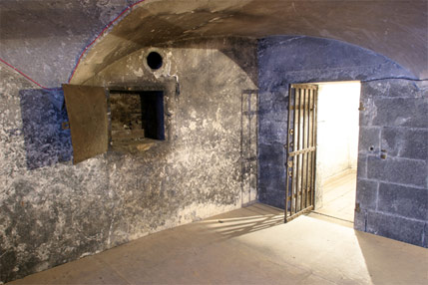
His most pressing problem was what to do with the aftermath of the Rebellions.
Prisoners from the Rebellions were still languishing in jail.
Estimates put the number of people involved in the Rebellions at about 20 000, with 13 000 of them in Lower Canada.
More than a thousand had been arrested.

Slide 9
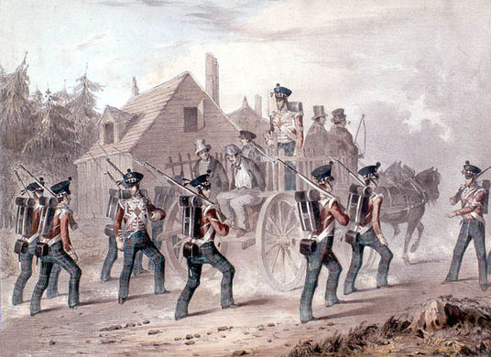
More than a thousand had been arrested.

Slide 10
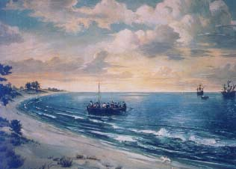
He realized that it was virtually impossible to obtain fair trials or to secure guilty verdicts for the rebels from French-Canadian juries.
Lord Durham then took matters into his own hands.
After obtaining confessions from nine of the main Patriote leaders, he banished eight to Bermuda without trial, including Dr. Wolfred Nelson.

Slide 11
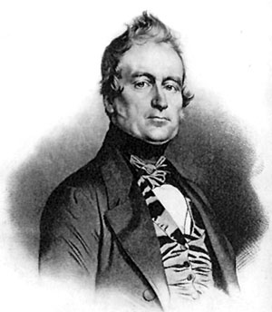
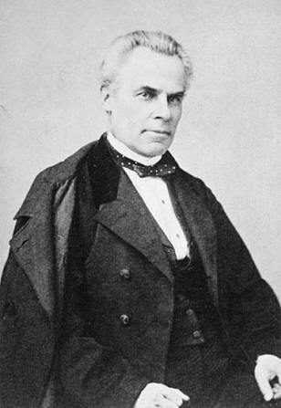
Durham then proclaimed a partial amnesty for 107 jailed rebels, but not for those 16 patriotes still in the US, including Louis-Joseph Papineau and George-Etienne Cartier.
Louis-Joseph
Papineau
George-Etienne
Cartier
These decisions would have far-reaching consequences as it led to his dismissal for having exceeded his authority.

Slide 12
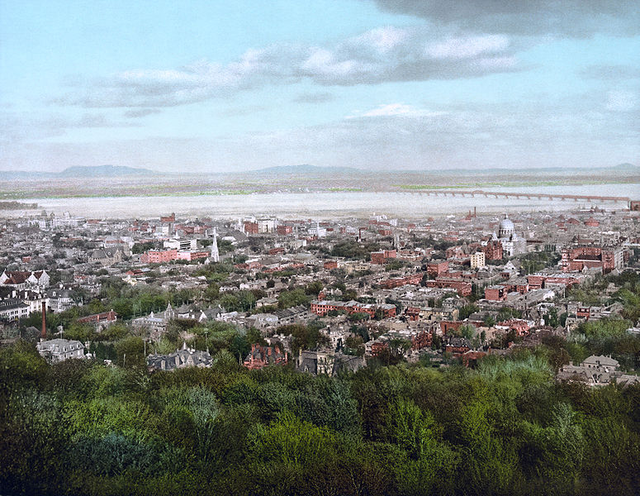
Unfortunately for the French, Durham did not consult with the French about their specific concerns.
Instead, he spent most of his time with English merchants of Montreal; and came to agree with their belief that English culture was superior to French-Canadien culture.
Montreal, 1838

Slide 13
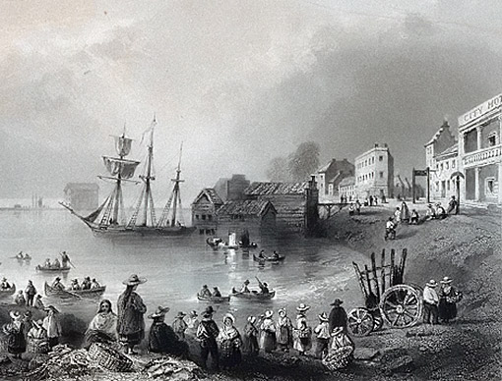
During his brief stay in Upper Canada, Lord Durham met with the father and son team of reformers William and Robert Baldwin.
The Baldwins blamed the culture of privilege enjoyed by the Family Compact and the lack of accountability in the colonial government for the civil unrest.

Slide 14
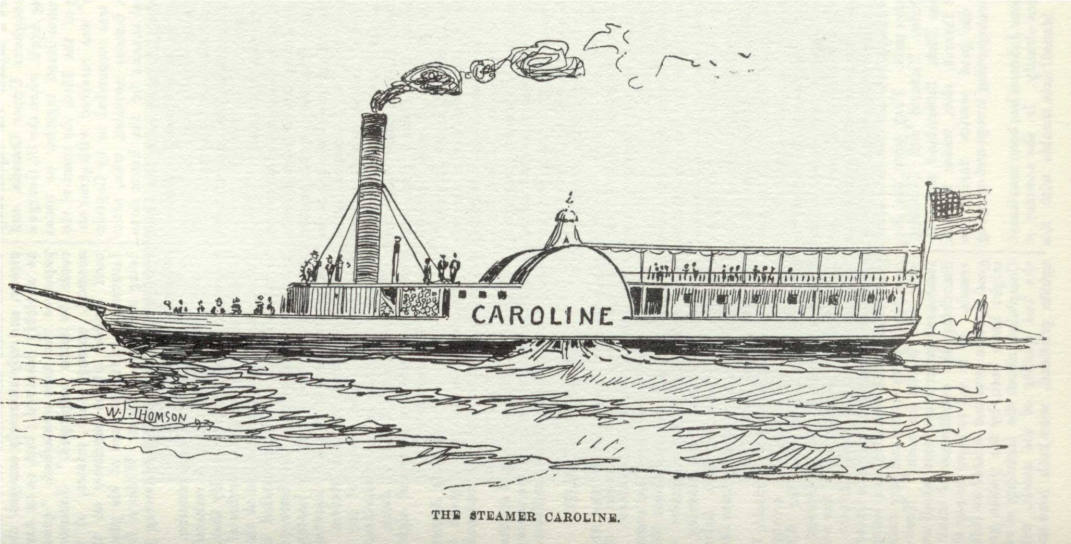
Durham also visited New York State to restore the Anglo-American relationship back to normalcy. (Canadians had killed an American citizen while sinking the Caroline.)
His mission to the United States was a complete success. There would be no American war with Canada.

Slide 15
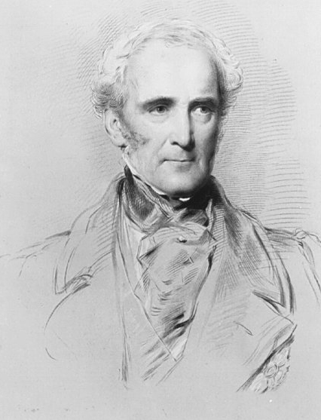
In September 1838, Durham learned that he was being recalled to London.
On October 9, he published his resignation sailed for England on November 1.
He was replaced as governor by John Colborne, Lord Seaton until Jan. 17, 1839.
Sir John Colborne, Lord Seaton

Slide 16
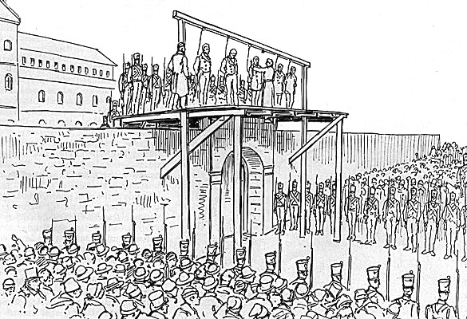
On December 6, 1838, Governor Colborne began to try to French Canadian rebel leaders through a British military court.
Nine of the men were acquitted (found not guilty).
99 men were found guilty and given the death penalty, but only 12 were executed.

Slide 17
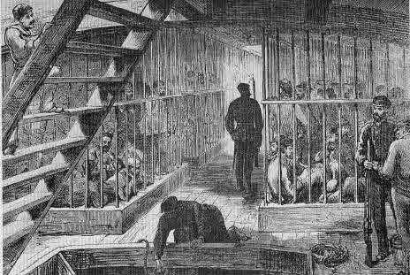
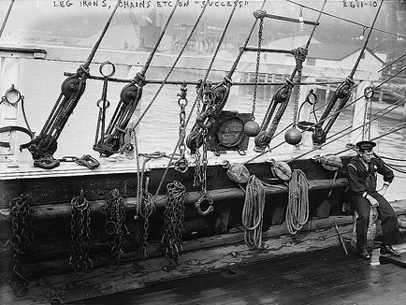
58 men were banished from the colony and sent to Australia.
Another 27 men were set free.

Slide 18
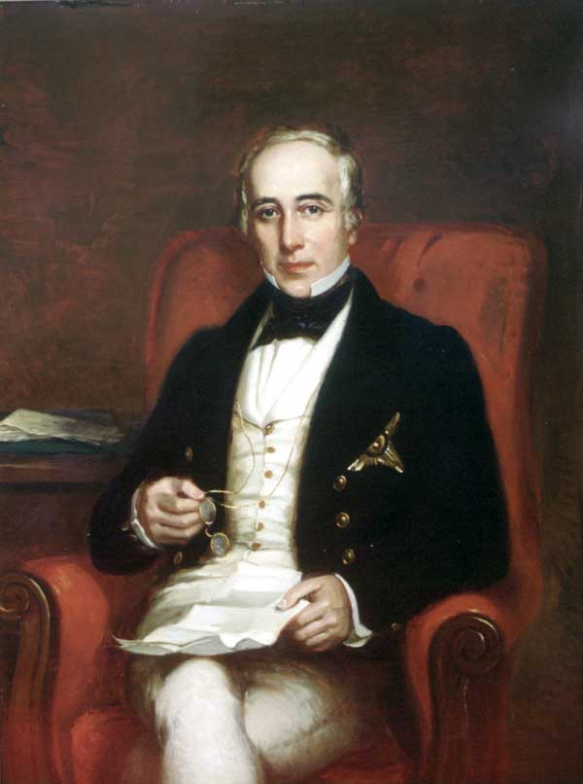
Upper Canada
Upper Canada received a new lieutenant-governor in 1838:
Sir George Arthur.
Sir George Arthur

Slide 19
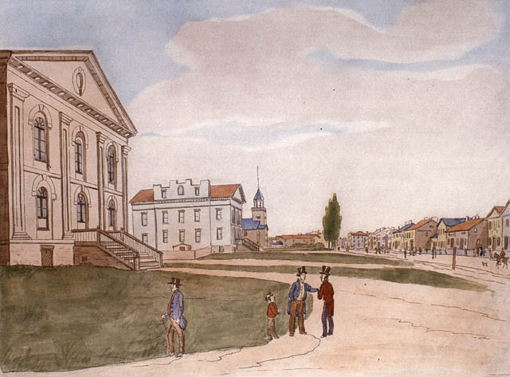
There were more than 1000 rebels in Upper Canadian jails.
Jails at this time were cold, very filthy, crowded, and the food was horrible.
Dozens of prisoners died in the jails without ever going to trial.
Toronto Courthouse & Jail

Slide 20
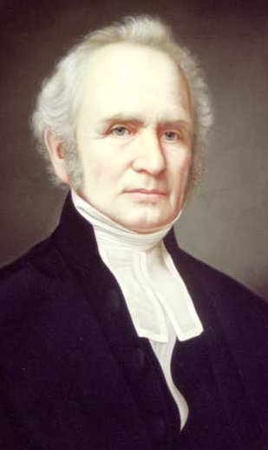
One of the first things George Arthur did when he arrived in the colony was sign the death sentence for two rebel leaders: Samuel Lount and Peter Matthews.
Although both men had plead guilty in their trials, the judge in their case, John Beverly Robinson, sentenced them to death.
Sir John Beverly Robinson

Slide 21
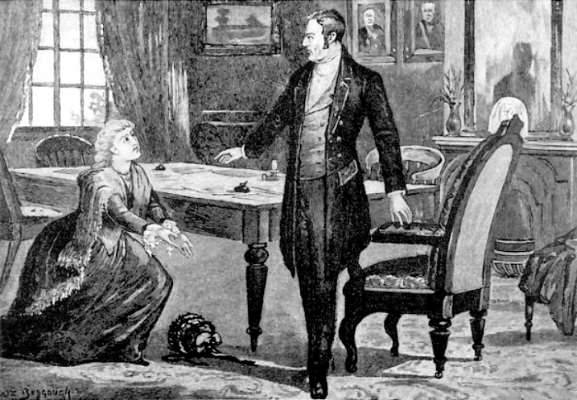
On behalf of Lount and Matthews, 35 000 people sent petitions to the Executive Council of Upper Canada asking for mercy.
Samuel Lount's wife, Elizabeth, personally pleaded with Arthur to spare her husband.
However, Arthur refused to change the sentence.

Slide 22
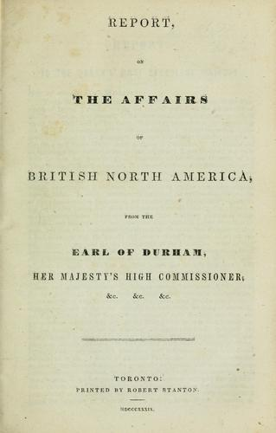
Durham only spent five months in Canada, during which he spent only eight days in Lower Canada.
Although he spent little time in the colonies, Durham wrote a report for the British government called the Report on the Affairs of British North America.
Most historians today call it Durham's Report.

Slide 23
Durham did not have any sympathy for the Patriotes in Lower Canada.
He did recognize that a cause of the rebellions in Lower Canada was conflict between English and French-Canadians.
Durham wrote in his report that,
"I expected to find a contest between a government and a people; I found two nations warring in the bosom of a single state; I found a struggle not of principles, but of races."

Slide 24
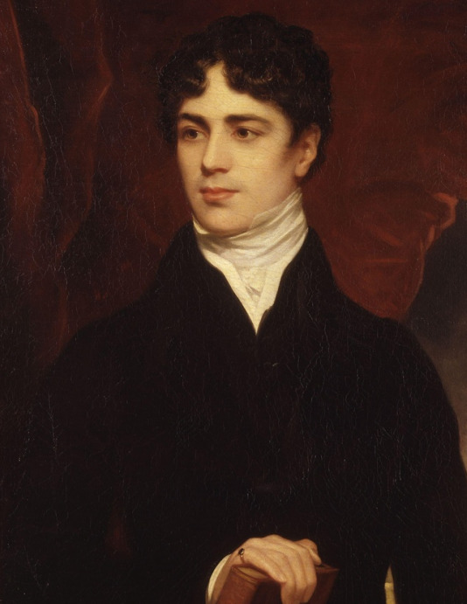
Durham came up with several recommendations to solve these problems.
A. First, he said Upper and Lower Canada should be joined together into one colony.
This would be the Province of Canada.
This new colony would only have one government.
Lord Durham

Slide 25
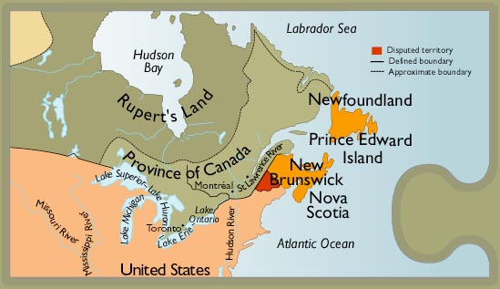
Both Upper and Lower Canada would have an equal number of seats in the new government: each to be given 42 seats

Slide 26
English should be the only official language of government.
Union meant that English representatives from both colonies would outnumber the French.
Outnumbered

Slide 27
Durham hoped this union of Upper and Lower Canada would help assimilate the French.

Slide 28
B. Durham also recommended that this new government be based on the idea of responsible government.
This was something the reformers in both colonies wanted.
The governor of the new colony would choose his executive council from whichever party held the most seats in the Legislative Assembly.

Slide 29
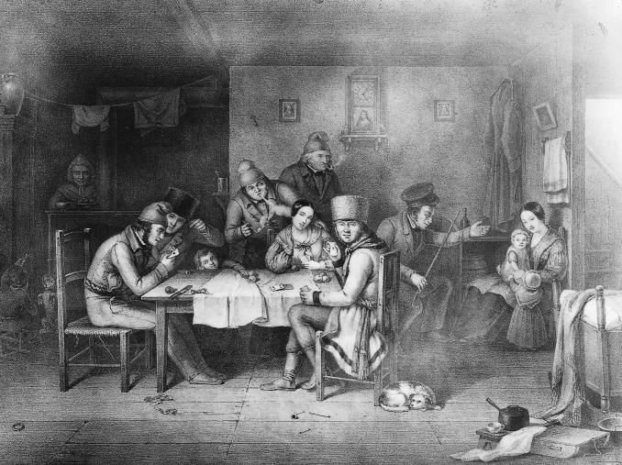
Durham saw matters from a decidedly racist perspective.
He saw the French as a people of no history or culture, backward, and priest-ridden.

Slide 30
However, his constitutional reforms would become the blueprint for change within Upper and Lower Canada.
One of the few suggestions that British authorities chose not to adopt was Durham's call for representation by population within the united parliament.

Slide 31
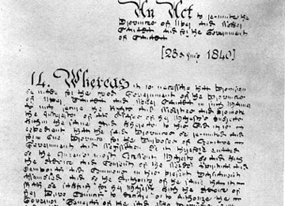
In July, 1840 the Act of Union was passed, and later proclaimed on February 10, 1841, by the British Parliament, uniting Upper Canada and Lower Canada under one government

