Slide 1
Lower Canada

Slide 2
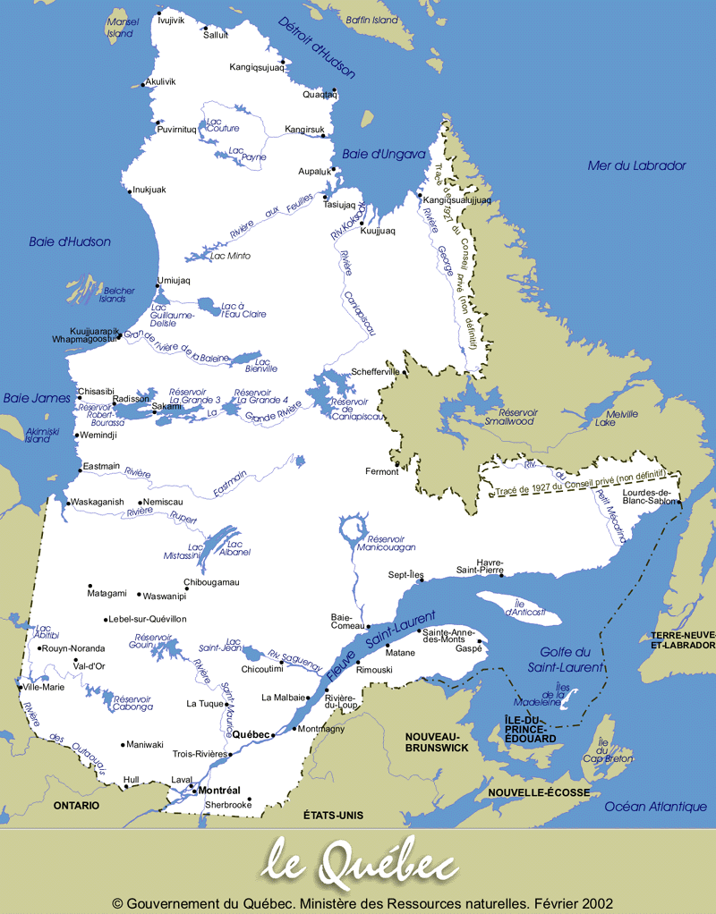
Despite its impressive size, the territory of Québec today is only a portion of what was once New France.
Québec

Slide 3
The original boundaries of Québec were changed through the
Royal Proclamation of 1763,
Québec Act of 1774,
Constitutional Act of 1791, and
British North America Act of 1867.

Slide 4
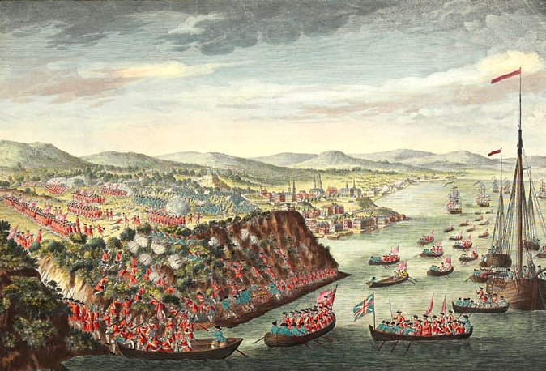
In 1759, the famous battle of the Plains of Abraham altered the course of the French colony's history that had been, until then, relatively uneventful. The English won the battle and took control of Québec City, then later New France.
The Taking of Québec, September 13, 1759.

Slide 5
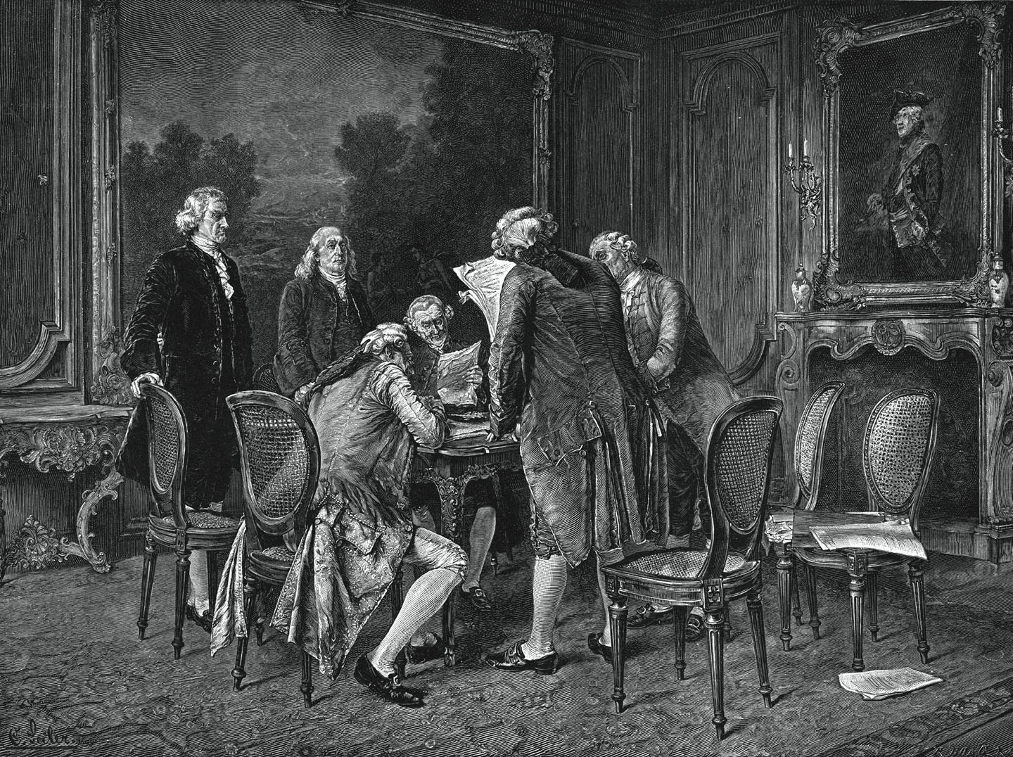
In 1763, France signed the Treaty of Paris, thus transferring ownership of New France to England and putting an end to the Seven Year War.

Slide 6
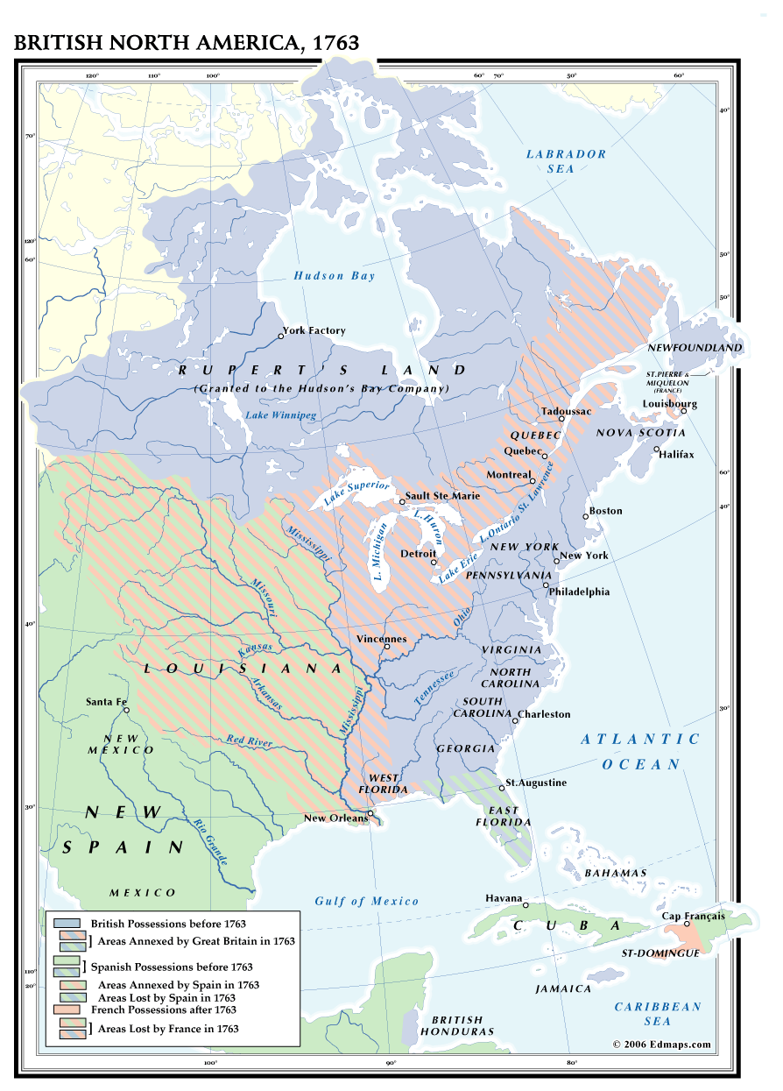
The British shocked knowledgeable people of the day by choosing to take the barren wasteland of Canada from France, rather than the prosperous West Indian sugar islands of Guadeloupe and Martinique.

Slide 7
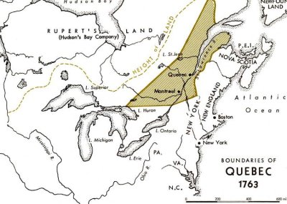
Soon after, the Proclamation Act of 1763 was introduced. This act established four new British colonies, one of which was Québec.

Slide 8
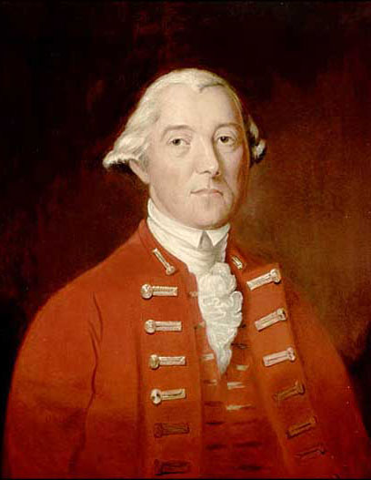
In 1774, the British Parliament passed the Québec Act to establish a permanent administration in Canada, replacing the temporary government created at the time of the Proclamation of 1763.
Governor Lord Guy Carleton
was largely responsible for the Québec Act.

Slide 9
The Québec Act of 1774
It recognized two basic rights of the predominantly French Canadian population:
Freedom of religion and,
The right to live under traditional French civil law (but subject to British criminal law).

Slide 10
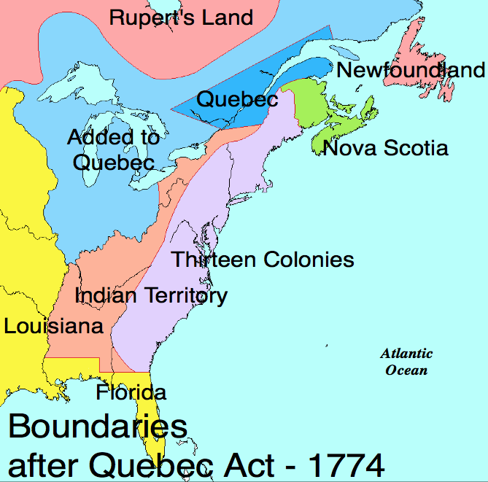
2. The Act extended the boundaries of the province of Québec to the Ohio River on the south and to the Mississippi River on the west.

Slide 11
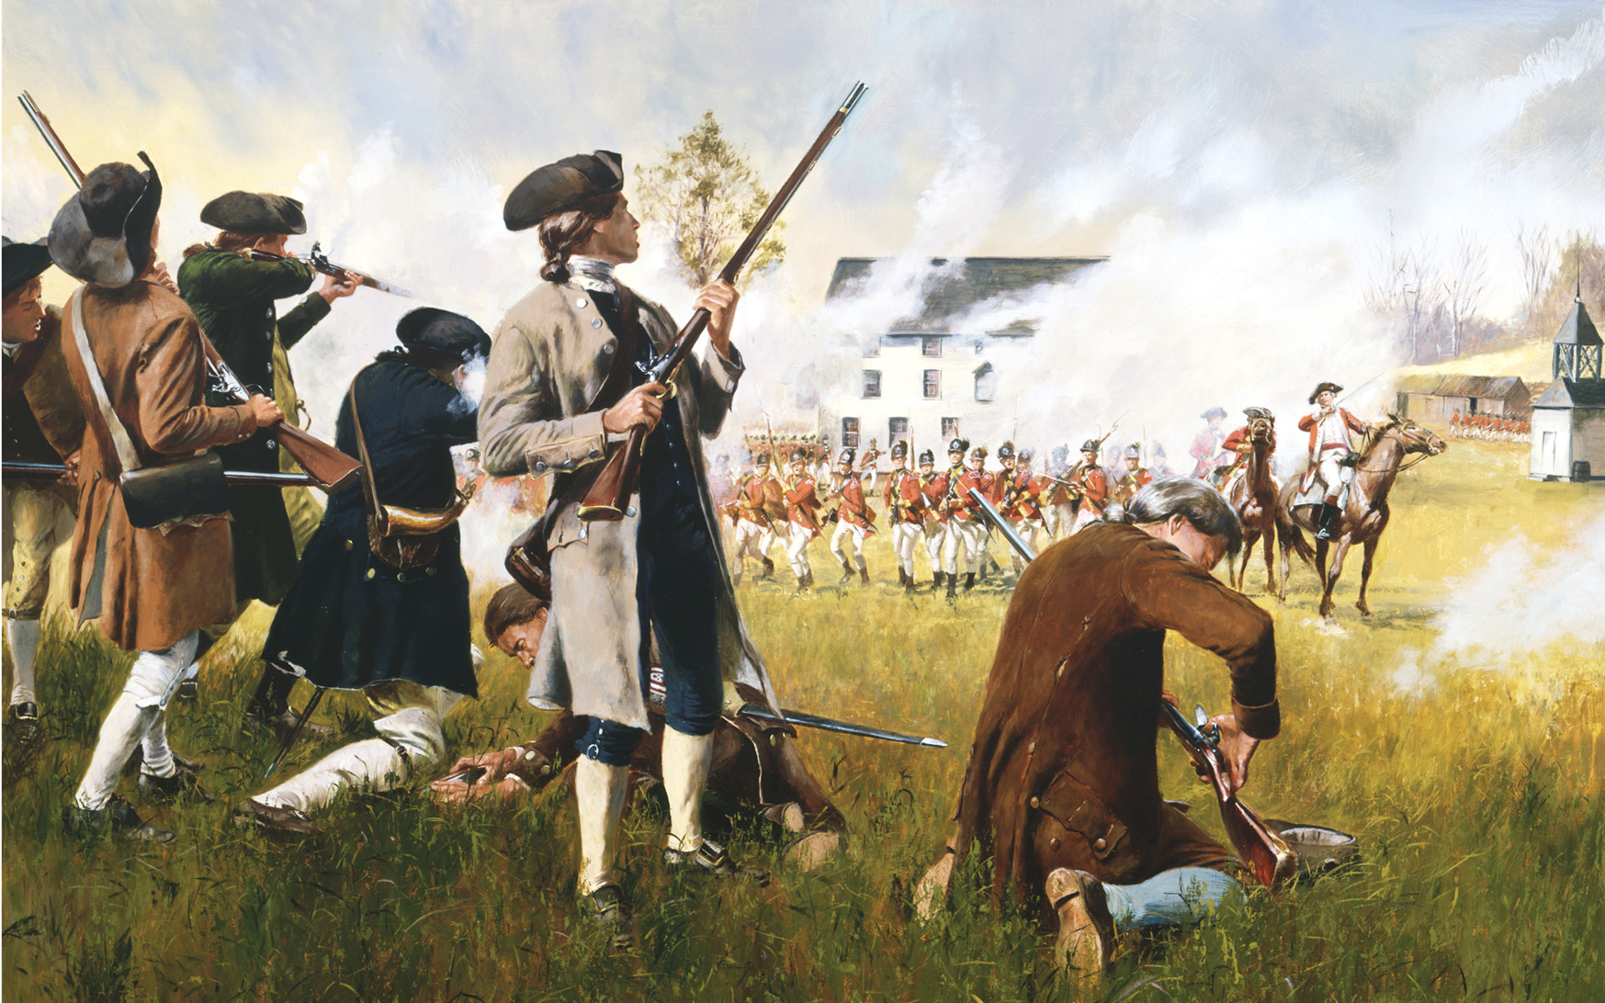
The Thirteen Colonies considered the Québec Act one of the Intolerable Acts that triggered the American Revolution, for it nullified many of their western land claims.

Slide 12
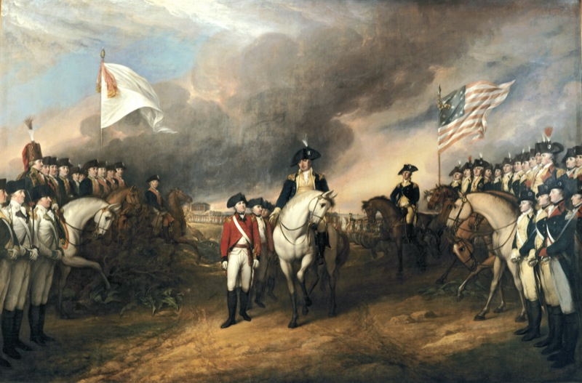
In the period following the American Revolution, many decisions the British made about their remaining North American colonies were a direct result of what had happened during the revolutionary conflict.
The surrender of British General Cornwallis at Yorktown, Virginia in 1781.

Slide 13
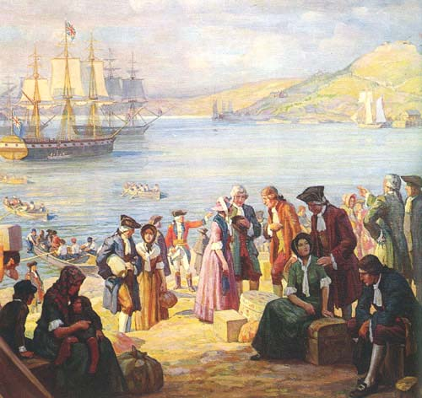
The Province of Québec and the Maritime colonies were significantly affected by the war. Throughout and following the conflict, nearly 40 000 Loyalists fled northward.

Slide 14
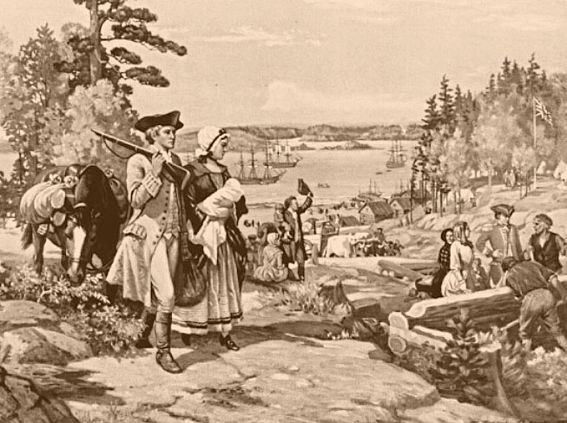
The reorganization of British North America under the Constitutional Act was a response to the pressure of thousands of Loyalists seeking refuge.

Slide 15
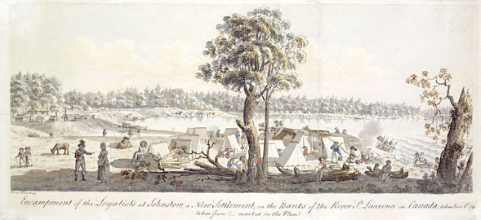
The appeals of the loyalists caused a great problem for the British government.
Measures taken in the Québec Act to conciliate the French could not be withdrawn.

Slide 16
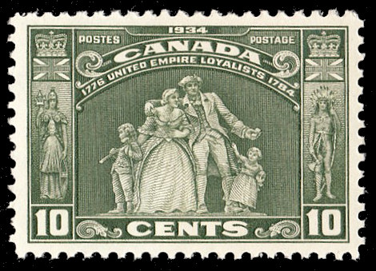
Yet the loyalists could not be required to live
under French civil and land law, and
b) without the representative assembly to which they were accustomed.

Slide 17
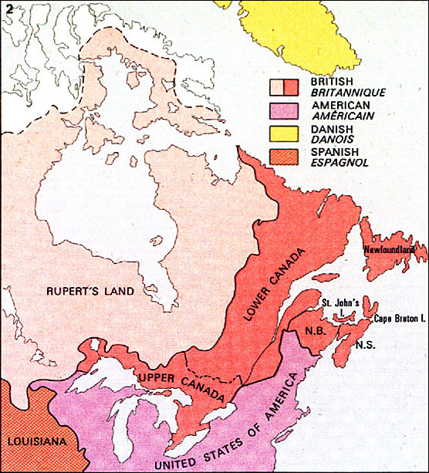
One obvious answer was to divide Québec into separate French and English provinces.
The Constitutional Act of 1791 divided the "Province of Québec" into Upper and Lower Canada.
Québec City became the capital of Lower Canada.

Slide 18
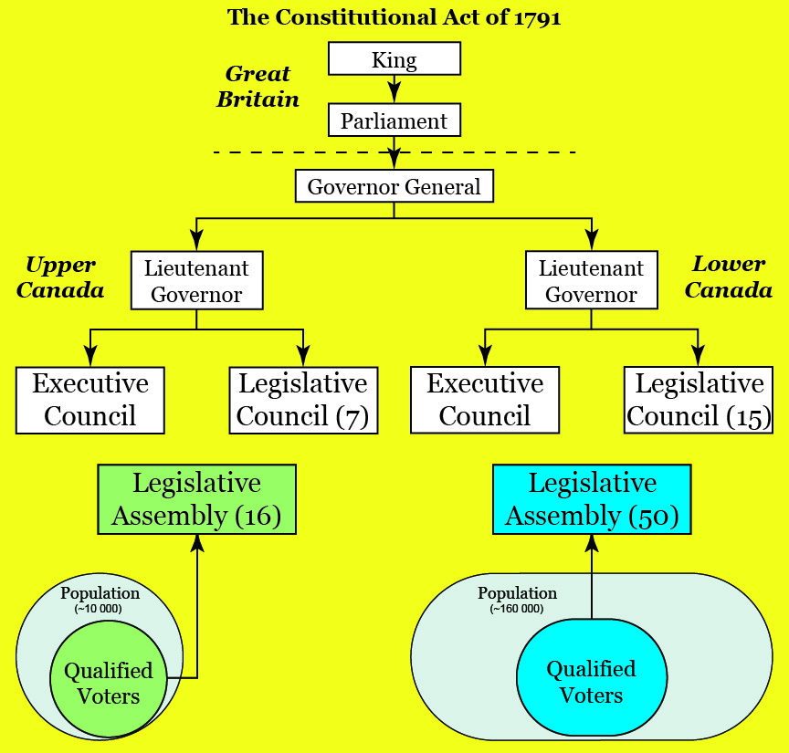

Slide 19
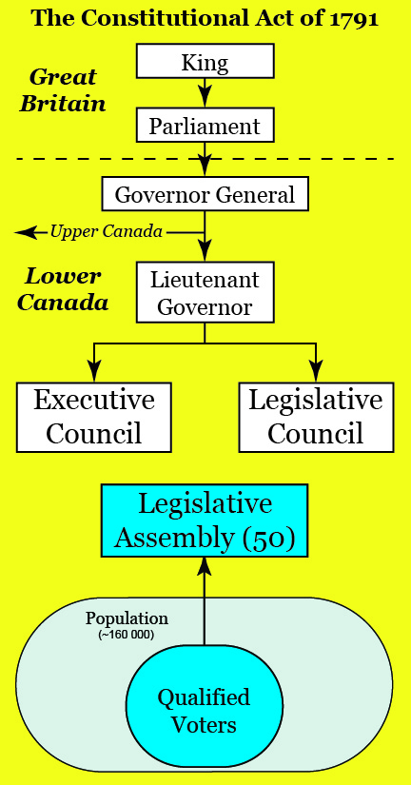
Parts of the Québec Act (1774) which defined the makeup and powers of government were repealed.
The Act provided for an appointed legislative council and an elected legislative assembly.
Gave power over taxation given to the assembly.
Gave the Governor power to withhold assent to bills passed by the legislative council and assembly.

Slide 20
The executive (i.e. the Governor and Legislative Council) was "irresponsible." That is, it was financially and constitutionally independent of the Legislative Assembly, and had the power to dissolve the Assembly.
This was no different than in Britain - but in Britain the king would rarely act unless his ministers approved. These ministers were responsible to Parliament.

Slide 21
What is a Representative Government?
A government in which representatives are elected by people to make laws on their behalf.
What is a Responsible Government?
A government that can be voted out of office if elected representatives fail to please the majority of people who elected them.
What is a Democratic Government?
One which is usually both representative and responsible.

Slide 22
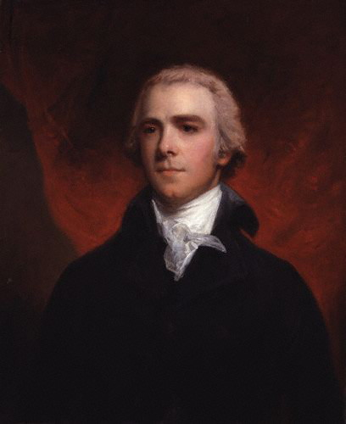
Rather than impose taxes and levy's from England, the Governor of the colony was responsible for imposing revenue generating policies in the colony in conjunction with his appointed council.
William Grenville,
British Colonial Secretary,
Prepared the Constitutional Act of 1791

Slide 23
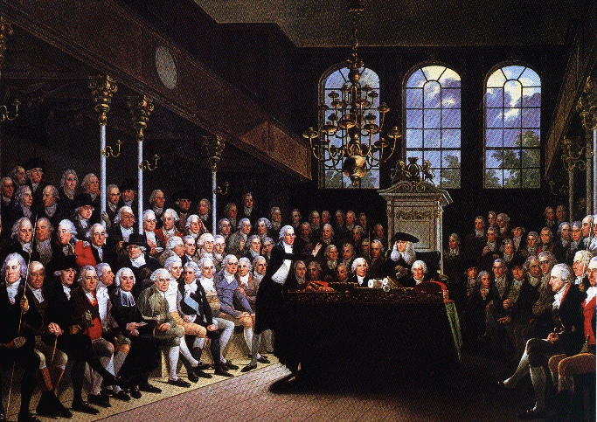
This increased the real power of the Governor and removed Parliament in London from any blame concerning fiscal and taxation issues in the Canadas.
British House of Commons

Slide 24
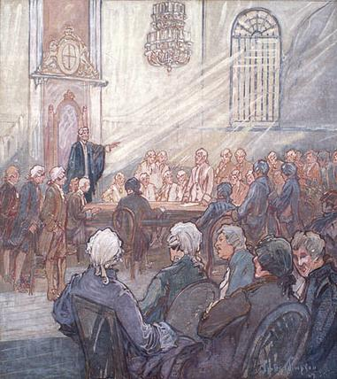
In Canada this led to abuses by governors on one hand, and to more extreme attitudes and actions by the frustrated colonial assemblies on the other.
The Legislative Assembly of Lower Canada, in the Chapel of Bishop's Palace, Quebec City.
Painting by Charles Walter Simpson, 1927.

Slide 25
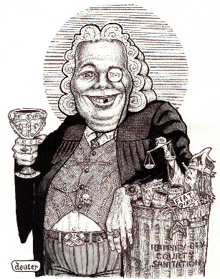
Matters were made worse by the fact that the executives were controlled by a small group of friends and acquaintances of the governors, connected by family, patronage and similar conservative ideologies.
These groups were oligarchies. In Lower Canada the oligarchy was called the Château Clique.

Slide 26
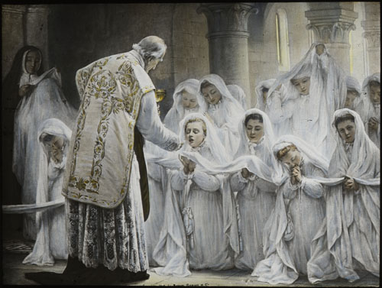
The Constitutional Act of 1791 also:
Declared that the Catholic faith should continue to be respected.

Slide 27
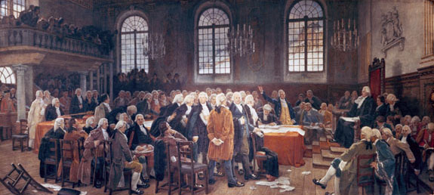
The Constitutional Act of 1791 also:
Made provisions for lands to be set aside to support the Protestant clergy in each province (clergy reserves).
Maintained French civil laws in Lower Canada however both provinces were governed by the English criminal code.

Slide 28
Politics

Slide 29
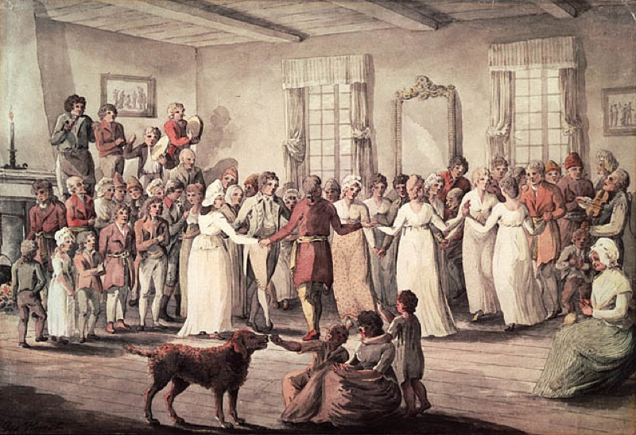
Colonial Oligarchy:
The Château Clique
Dancing at Château St-Louis

Slide 30
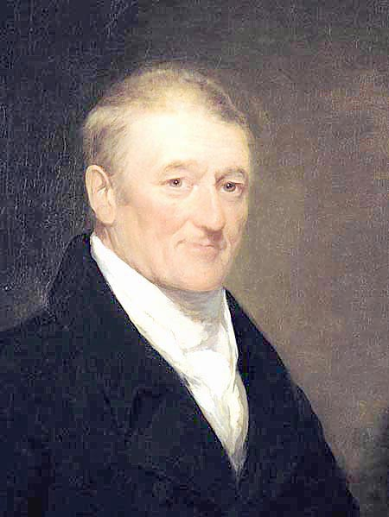
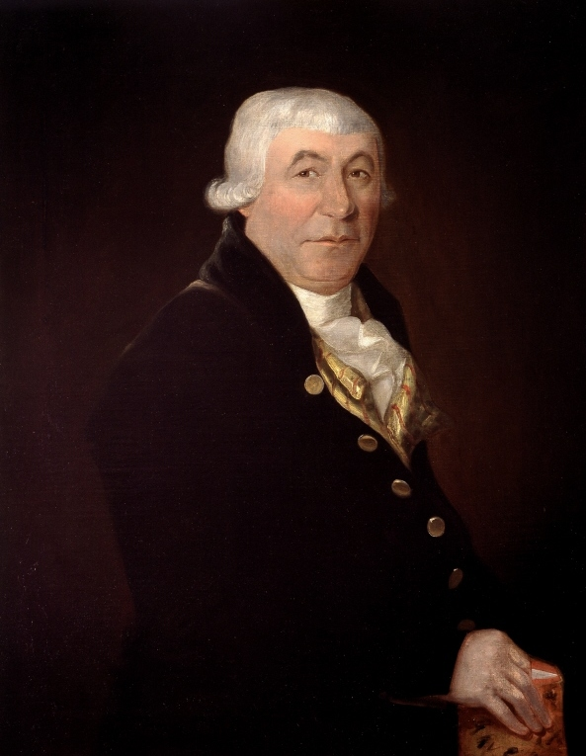
The Château Clique were usually members of the anglophone merchant community, and a few French-Canadians of the upper or seigniorial class, who dominated the executive and legislative councils, the judiciary and senior bureaucratic positions of Lower Canada until the 1830s.
John Molson
James
McGill

Slide 31
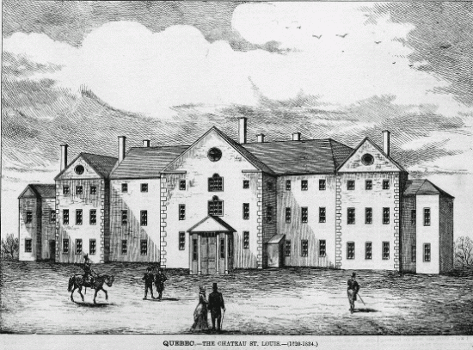
The nickname “Château Clique” was used because of the proximity of the Governor’s residence in the Chateau St. Louis located beside the government offices.

Slide 32
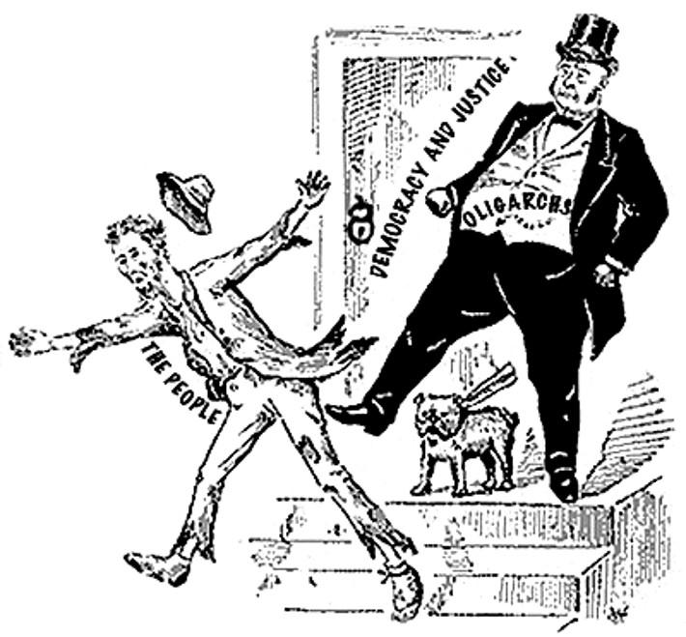
The members of the Château Clique held positions of authority and often acted in their own interests rather than the interests of the people of the province.
In Lower Canada, the Château Clique blocked reform efforts and continued to work toward the assimilation of the French-speaking population.

Slide 33
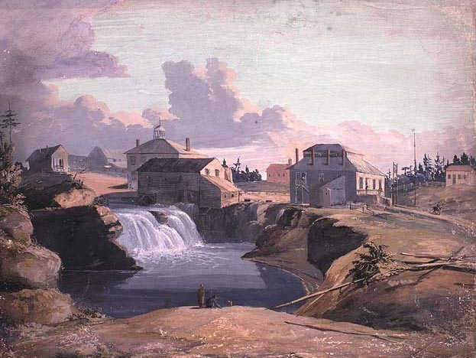
The Clique was led by English speaking merchants who had been able to squeeze the French Canadians out of political power and take control of both the executive and legislative councils.
Henry DuVernet, "A View of the Mill and Tavern of Philemon Wright at the Chaudière Falls, Hull on the Ottawa River, Lower Canada" (1828)

Slide 34
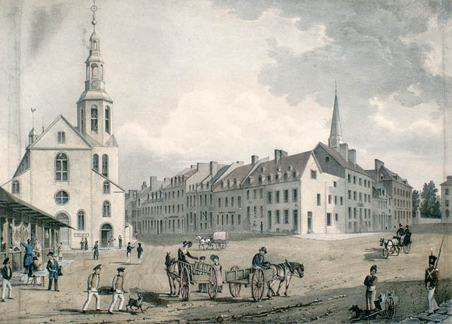
They systematically began appointing mostly English Canadians into government positions or hiring them as civil servants.
Quebec City

Slide 35
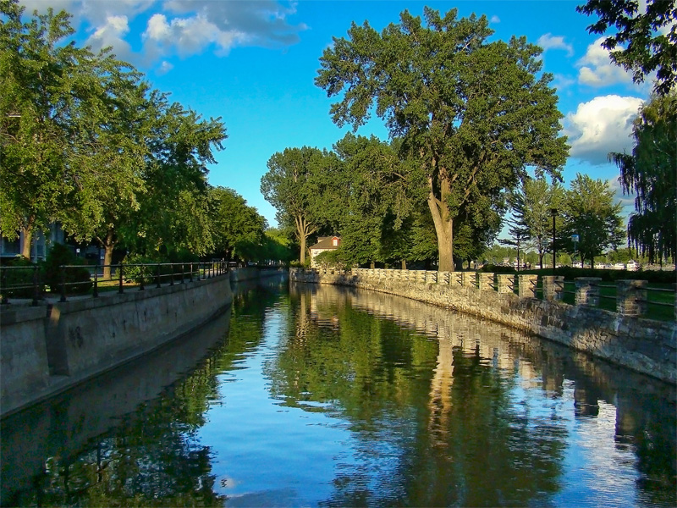
The Clique aggressively pursued canal building, the establishment of banking institutions, and the abolition of the Seigneurial System and French Civil Law.
Lachine Canal, near Montreal

Slide 36
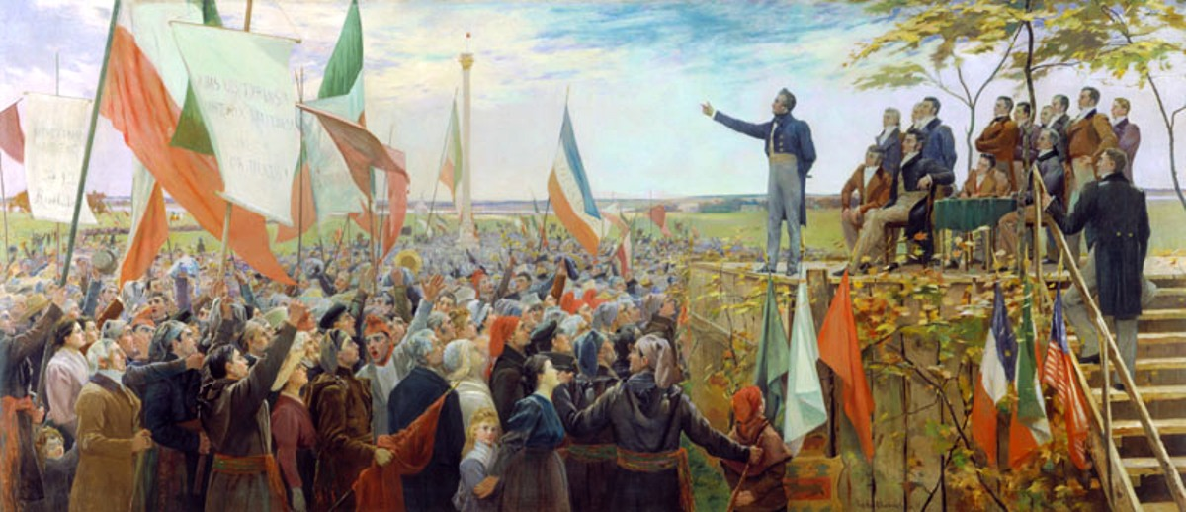
A dynamic new political elite drawn from the Canadien professional and rural merchant classes formed the Parti Canadien.
They gained control of the Legislative Assembly.

Slide 37
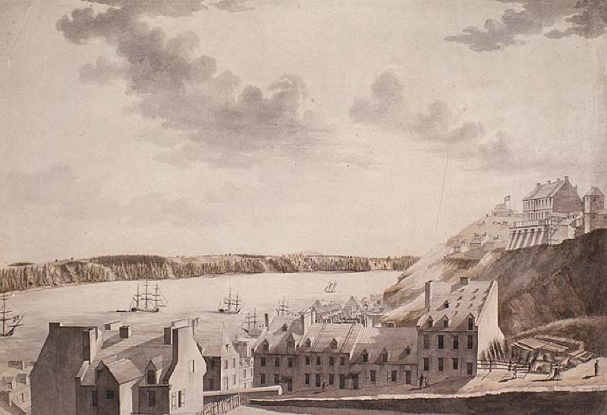
With the loss of control over the legislature, the Château Clique became increasingly dependent on the governor to maintain its influence.
The Chateau St. Louis, the Governor’s Residence (upper right).

Slide 38
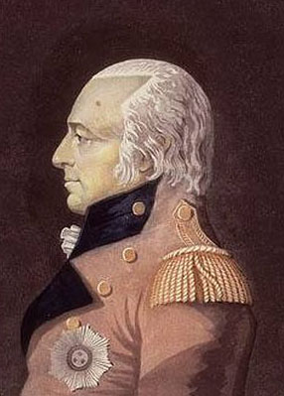
While Governor General of the Canadas and an administrator of Lower Canada from 1807 to 1811, Sir James Henry Craig tried to influence the elections of 1809 and 1810, imprisoning without trial leaders of the Parti Canadien in March 1810 in what was called a "reign of terror."
Sir James Henry Craig

Slide 39
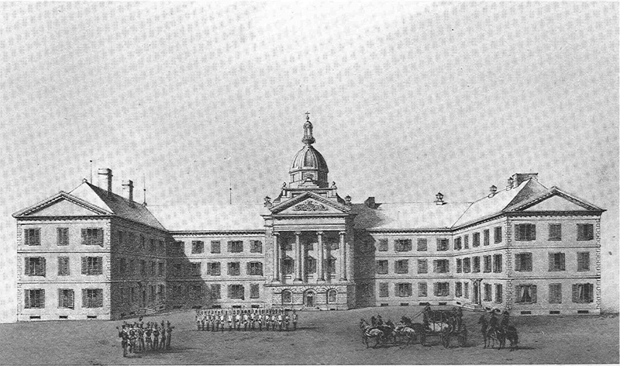
The Château Clique tried to undermine the Parti Canadien grip on the legislature.
By using their substantial contacts in London, the Clique lobbied for legislation to unite Upper and Lower Canada, and diminish the Canadien majority. But a Union Bill in 1822 failed.
First Parliament Building in Quebec City, which burned in 1854.

Slide 40
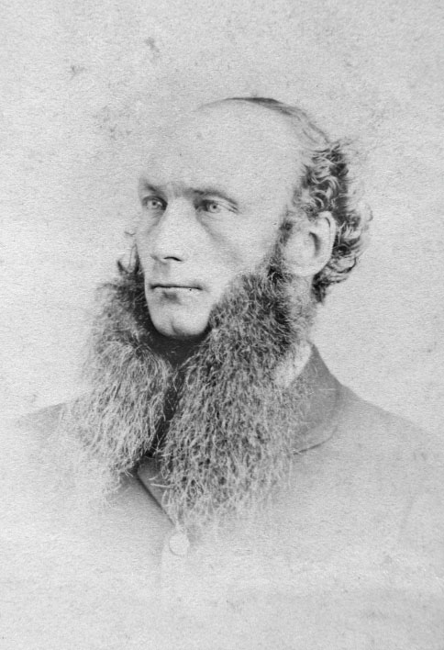
Led by Herman Ryland, members sought to assert control through a policy of anglicization of the Canadien populace.
Herman Ryland

Slide 41
In addition, increased immigration and population growth created tensions over unsettled lands in the Eastern Townships, which was dominated by the Canada Land Company.

Slide 42
Consequences of the Constitutional Act of 1791:
In short, the Constitutional Act was simply a refined re-run of the system of royal colonial government that had failed in the 13 Colonies.
Like the Americans the people of Canada were to be subject to the vetoing powers of governors, un- elected councils and the Imperial parliament.
Governor James Craig

