Slide 1
French Canadian Population Growth

Slide 2
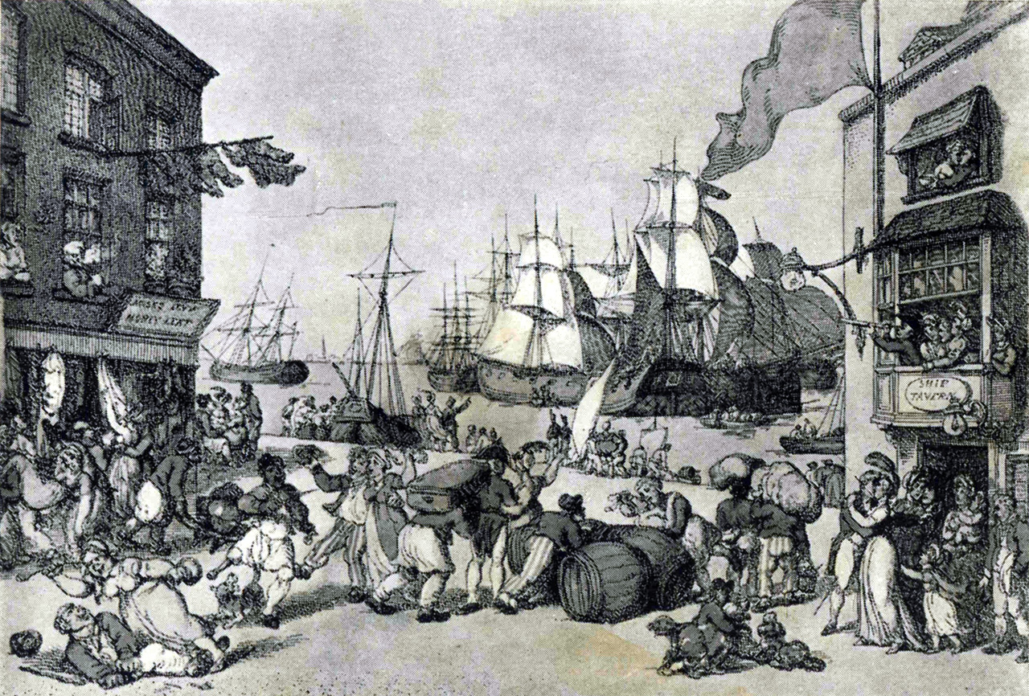
During the French colonial period, France was Europe's dominant power. Its population during the 18th century was between 20 and 25 million inhabitants while that of the British Isles was estimated at 7 million.

Slide 3
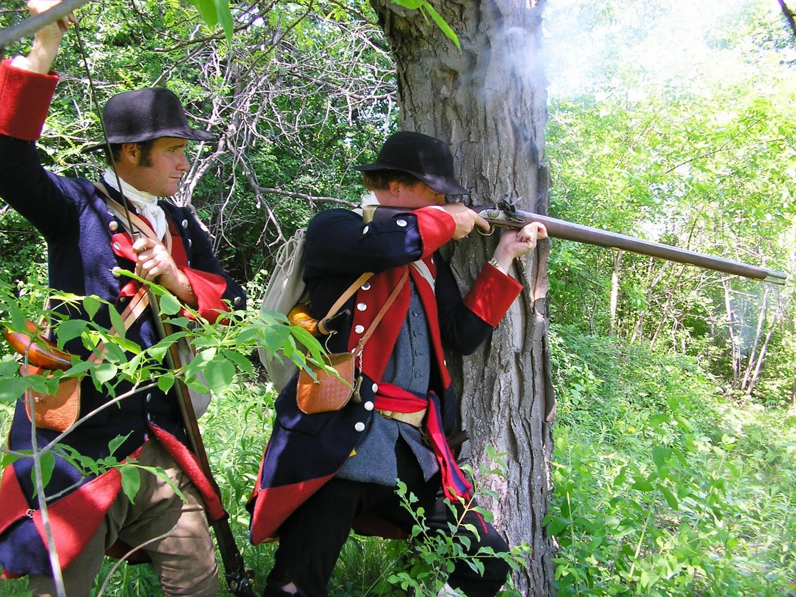
Colonial rivalry between France and Britain was already global during the 18th century. Competition between the two nations had implications for all continents.

Slide 4
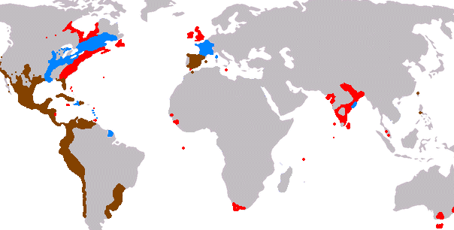
But France, despite an impressive system of colonies, remained mainly a continental power during the 18th century while Britain was building an international system of colonies.
English
French
Spanish

Slide 5
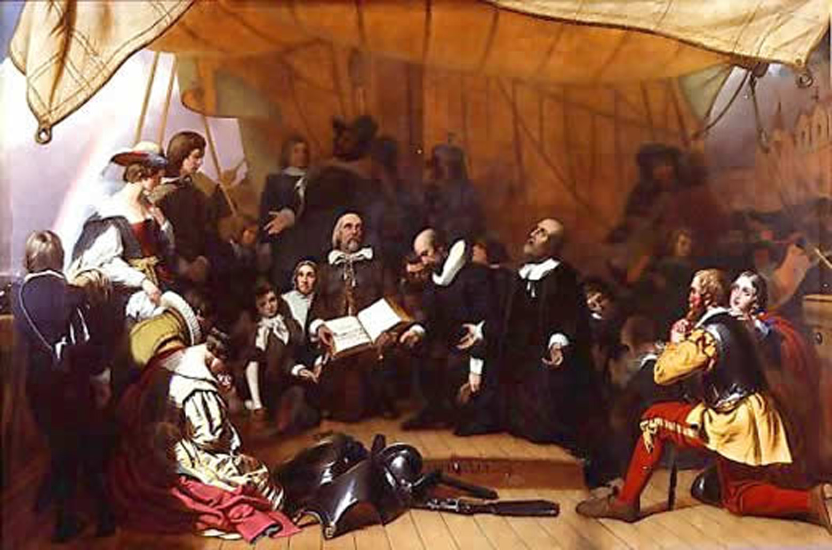
At the end of the 17th century, religious minorities in Europe sought to emigrate in order to build societies according to their religious beliefs.

Slide 6
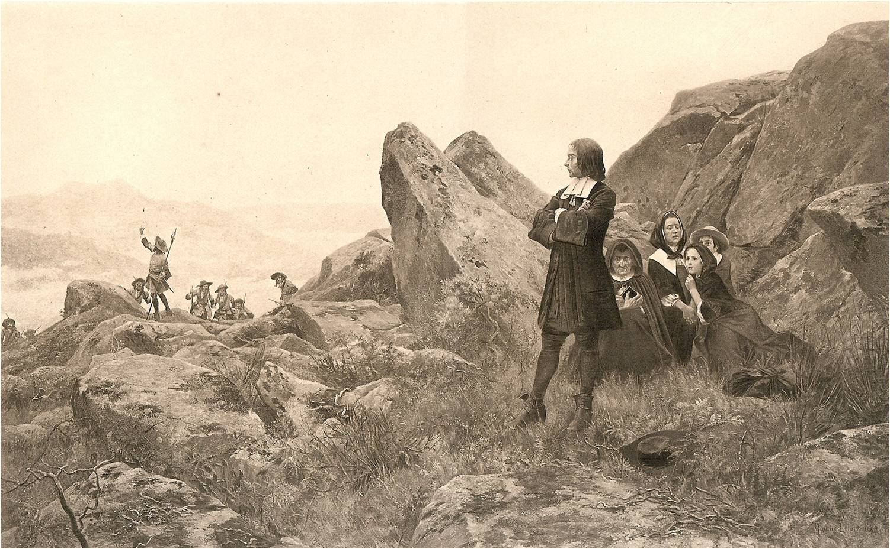
France's minorities, such as the Huguenots (French Protestants), mainly moved to Central Europe while religious minorities in Britain emigrated to North America.

Slide 7
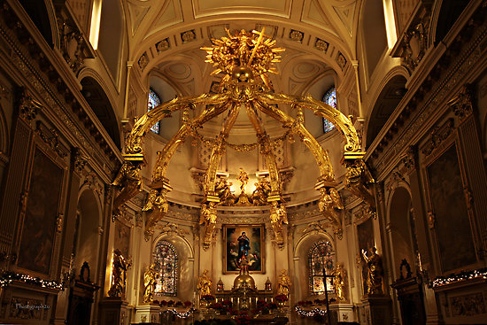
The refusal of the Catholic Church to allow religious minorities to move to New France, and the fertile soil and temperate climate of the Atlantic seaboard, led to a great disparity in the populations of New France and New England.
Notre-Dame de Quebec Basilica-Cathedral, Quebec City, Built in 1633.

Slide 8
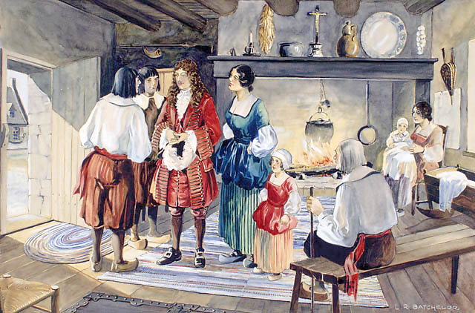
Between 1608 and 1713, despite the success of its expansion on the continent, New France's population had grown from several hundred to only 15 000 inhabitants.

Slide 9
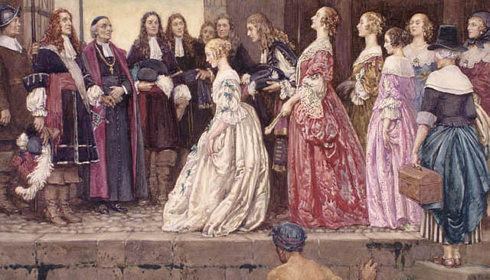
In an attempt to increase the population of New France, King Louis XIV financially sponsored the emigration of the “Filles du Roi”, or King's Daughters, 770 women who arrived in the colony between 1663 and 1673.

Slide 10
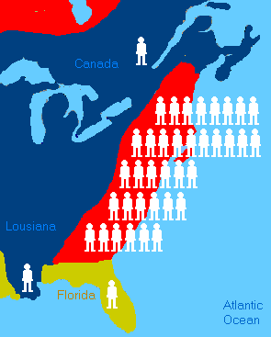
By 1715, New England had a population of 400 000 and more than 2 million in 1763.
Between 1715 and 1763 the population of New France grew from 15 000 to almost 70 000 inhabitants.

Slide 11
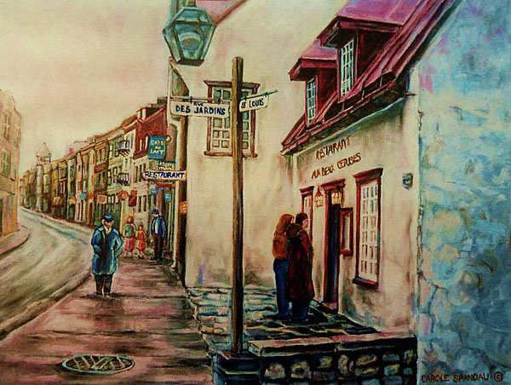
Lower Canada
It was under the English regime after 1763 that the remaining French-speaking population grew substantially. From less than 70 000 the French population increased to some 100 000 in 1784, over 400 000 in 1825 and almost a million in 1860.

Slide 12
By 1911 the French-speaking population in Québec was about 2 million people, 4 million in 1951 and almost 6 million in 1996.
Between 1840 and 1930 one million French-Canadians, most of them seeking jobs in the manufacturing sector in New England, left Québec for the United States. Today, the estimated Franco-American population is 5 million people.

Slide 13
Of the total population of Quebec, nearly half are descendants of the 10,000 original French settlers. Québécois constitute more than four-fifths of Canada’s total Francophone population.
About one-tenth of Quebecers are Anglophones of British descent.

Slide 14
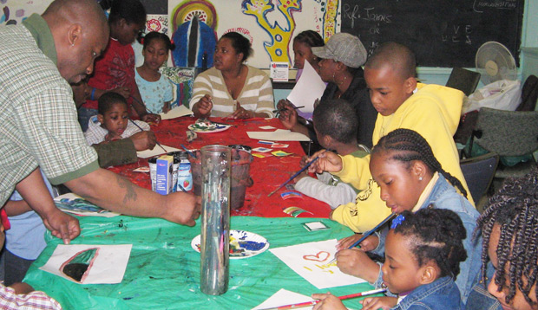
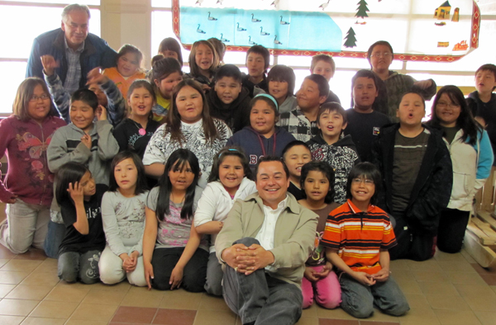
Another tenth of the population is of neither French nor British descent and includes aboriginal peoples (First Nations and Inuit), eastern Europeans, Portuguese, Greeks, Haitians, and Asians (notably from Southeast Asia).

Slide 15
Lower Canada
Part 2

Slide 16
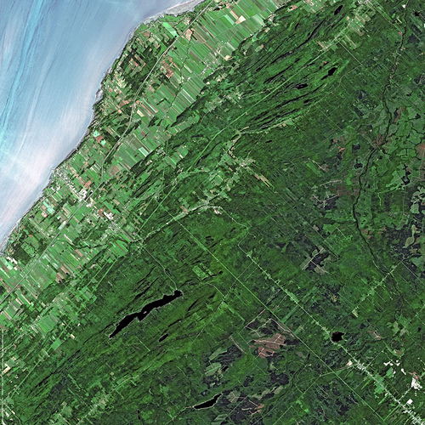
Seigneurial System
During the time of New France, land was settled in a distinct fashion. The seigneurial system, abolished in 1854, was organized to give each habitant access to water, good soil in the river bottom, and timber further from the river.

Slide 17
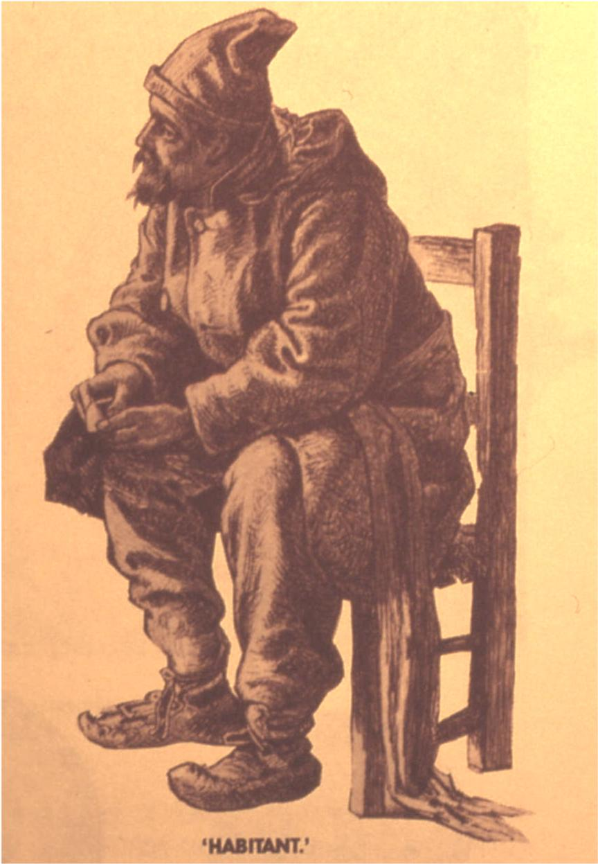
Seigneurial System
Habitants were usually farmers or labourers who were initially brought over from France to live on this land. They had to pay rent and taxes to the seigneur.

Slide 18
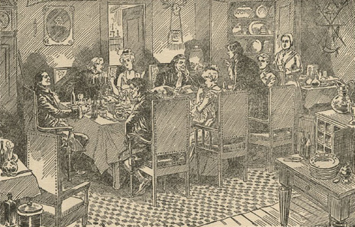
Seigneurial System
Seigneurs were the most important colonists in New France, as they were usually in the military or aristocracy prior to being a settler. These seigneurs then were charged with the task of subdividing large parcels of land into five by 15 kilometer concessions, then renting this land to a habitant.

Slide 19
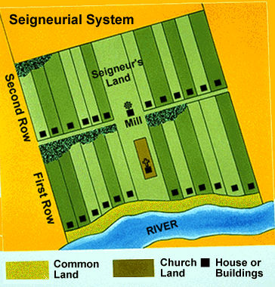
Seigneurial System
Individual lots within a seigneurie, usually built along a river, were very narrow, were about 175.5 m wide, and extremely deep, about 1700 m long.

Slide 20
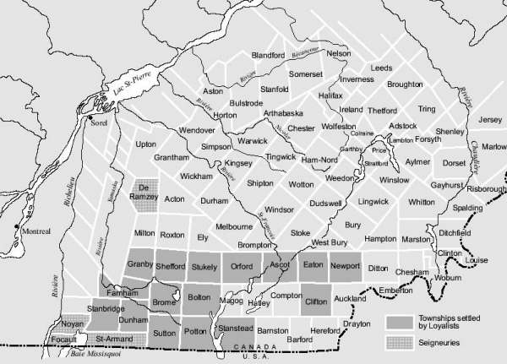
Under the Château Clique, English merchants and some seigneurs sought to develop new lands at the expense of the Canadien majority.
The
Eastern
Townships

Slide 21
The Rise of Montreal

Slide 22
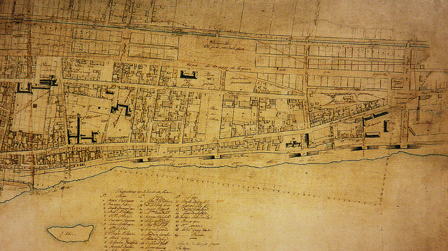
Street Plan of Montreal, circa 1810

Slide 23
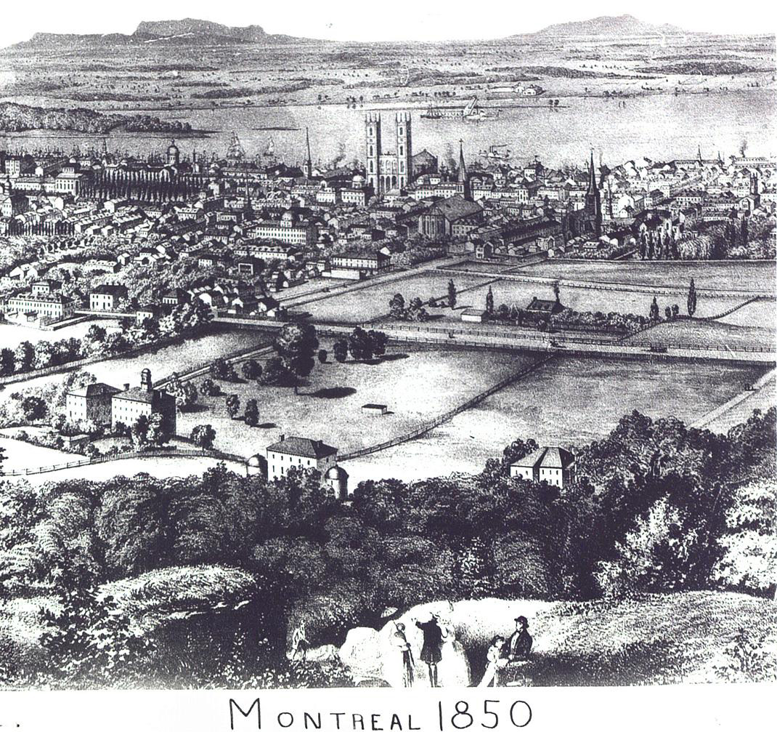
Montreal, 1850.

Slide 24
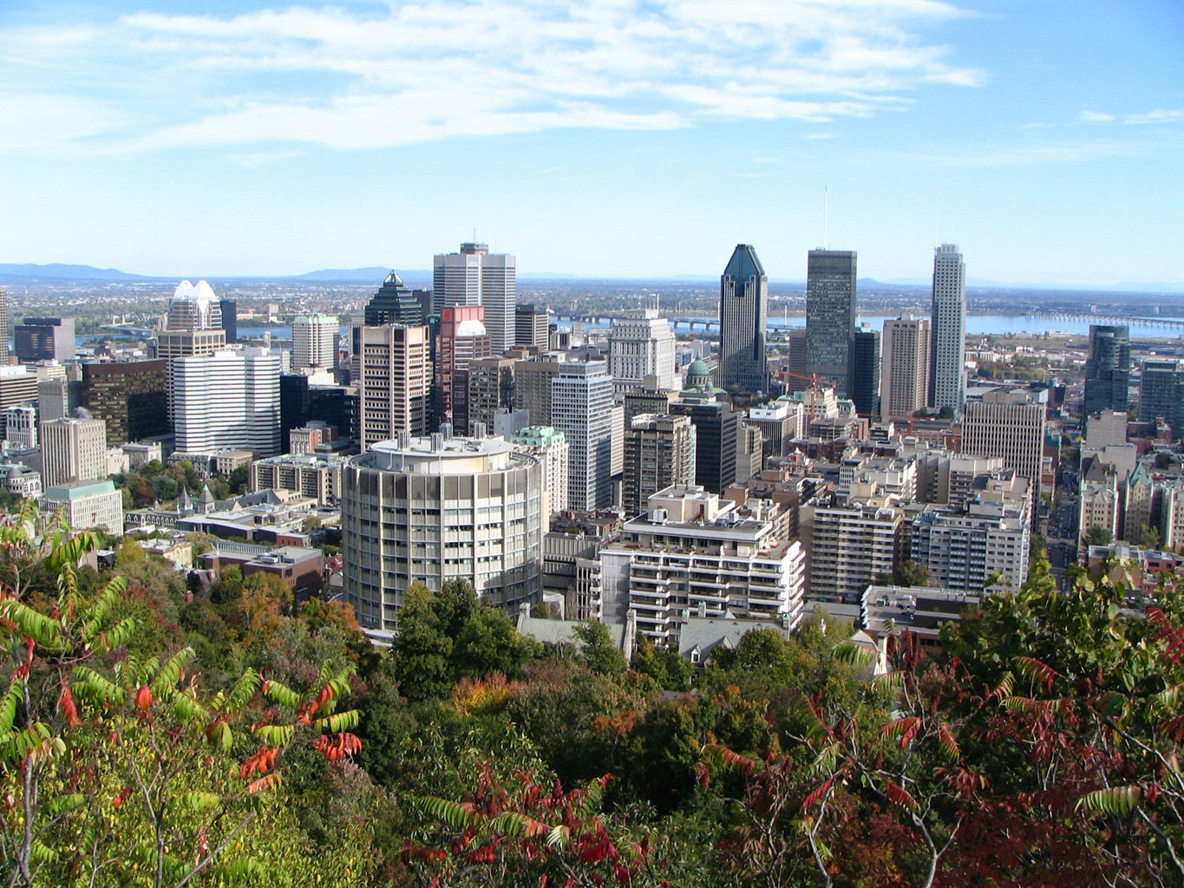
Montreal

Slide 25
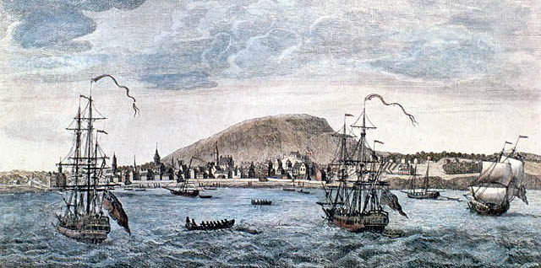
The end of the American Revolutionary War and the coming of the Loyalists led to a number of new developments in the province of Quebec, and particularly, its growing metropolis, Montréal.

Slide 26
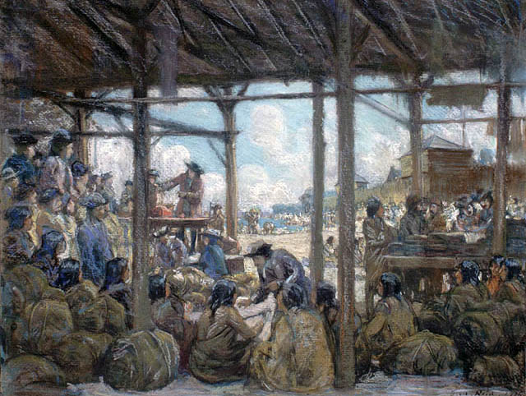
The business climate was revitalized by peace and stability, and by Montréal's continuing role in the western fur trade, and as an entrepot (distribution centre) for Great Lakes trade.
Fur Traders, Montréal

Slide 27
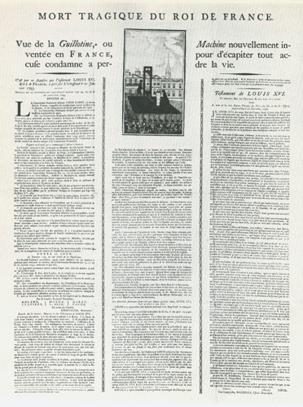
The level of literacy grew. In 1777, the first entirely French newspaper in Canada appeared in Montréal. In 1792, Canada's first magazine, The Quebec Magazine, was published.

Slide 28
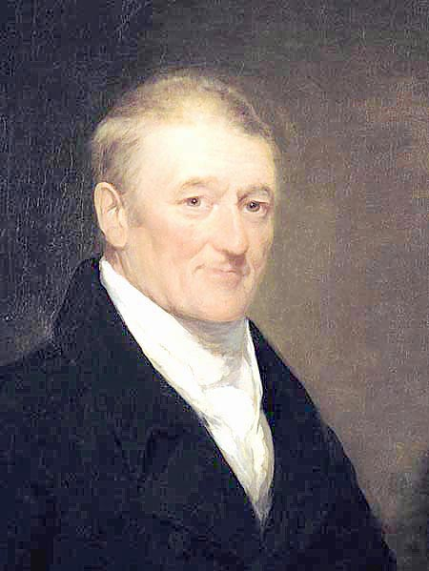
Apart from publishing, other businesses boomed as well. In 1780, Canada's first company shares were traded in Québec City, as a small stock exchange was set up.
On July 28, 1786 John Molson opened his brewery in Montréal.
John Molson

Slide 29
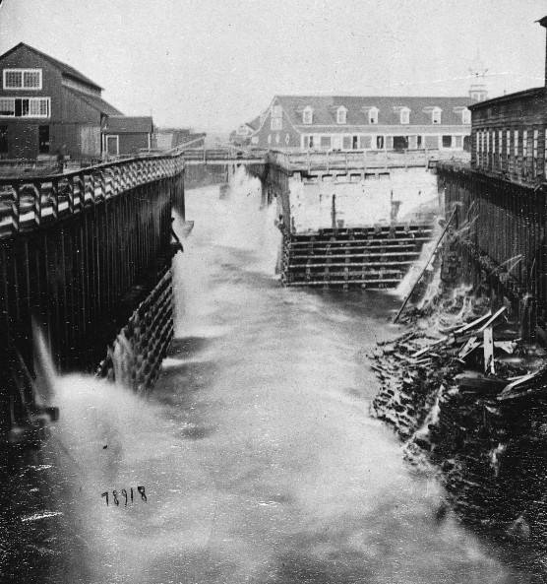
Philemon Wright, a “lumber baron”, made a large fortune from cutting and selling timber, and helped develop the hugely important timber economy in the Ottawa Valley.
William Notman, "Sawmill and tail race, Ottawa River."

Slide 30
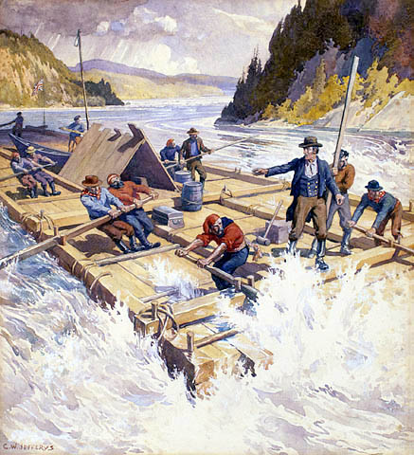
The demand for lumberjacks, log drivers, and sawmill workers brought people to the townships of the area. This lumber, especially the bountiful and prized white pine, was sold to continental and European markets.

Slide 31
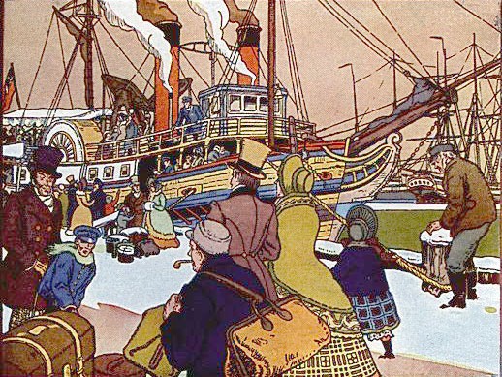
Better transportation stimulated industry. On August 19, 1809, Montréal brewer/banker John Molson launched his wooden paddle steamboat Accomodation.

Slide 32
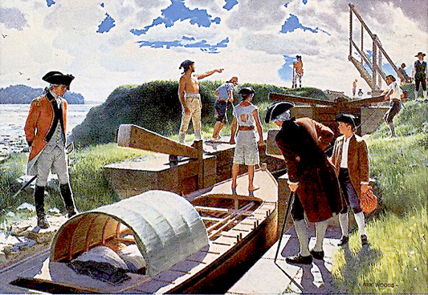
On February 15, 1781, William Twiss completed the first lock canal in North America, at Côteau-du-Lac rapids, on the Saint Lawrence upstream from Montréal.

Slide 33
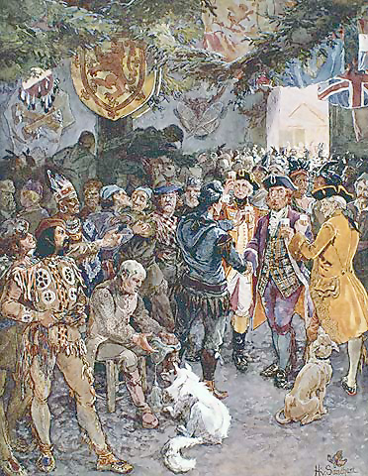
Perhaps the most important single business in Montréal at this time was the fur trade.
A number of shrewd and talented merchants, most of them Scots, took over where the traders of New France left off, competing with a formidable foe, the Hudson's Bay Company.

Slide 34
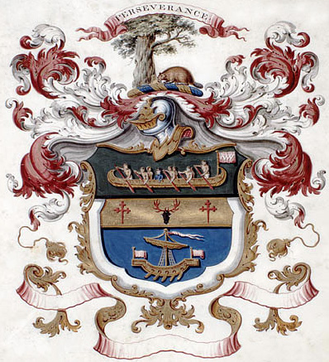
These traders, some of them allied with American Fur Company head John Jacob Astor, came to be known as the Norwesters, after their chief organization, the North West Company.

