Slide 1
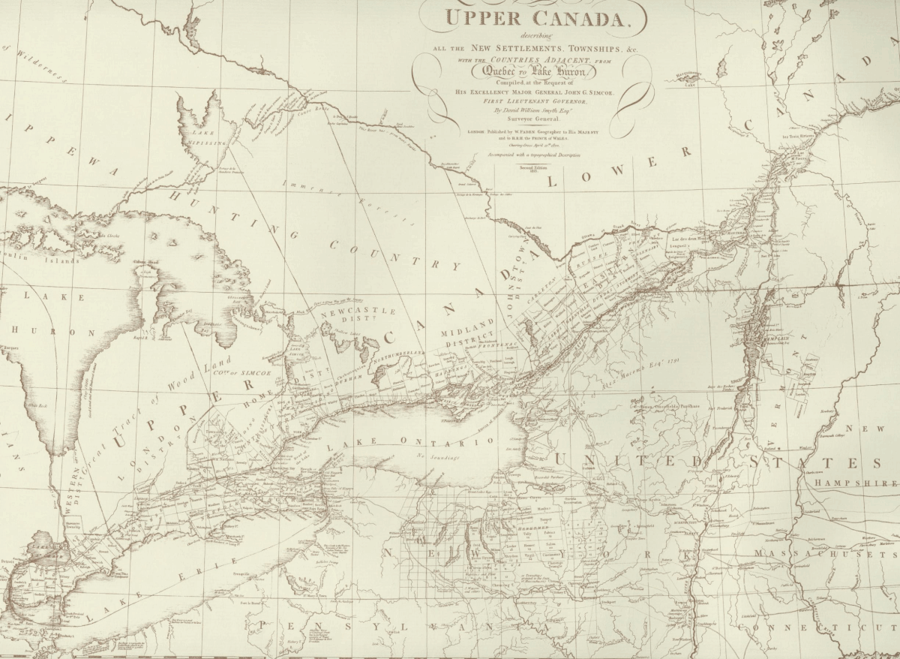
Upper Canada & The Immigrant Experience

Slide 2
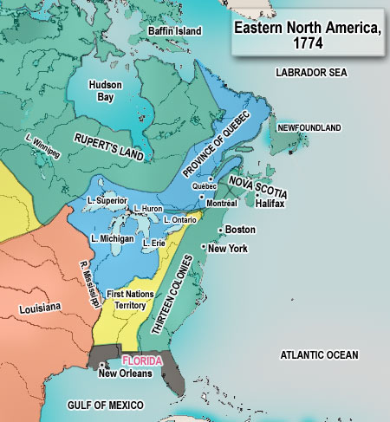
Upper Canada
In 1774,
the Quebec Act was a reorganization
of how the British territories were governed.

Slide 3
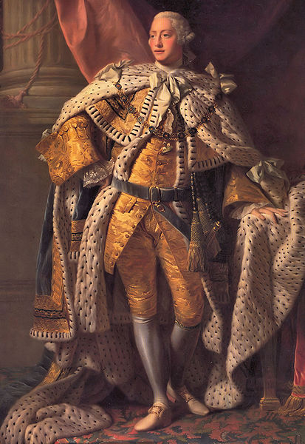
Upper Canada
American settlers
Were enraged when Québec acquired Indian territory to the west of the 13 colonies, which they perceived to be theirs by right;
They considered the Quebec Act one of the "Intolerable Acts” which contributed to the outbreak of the American Revolution.
King George III

Slide 4
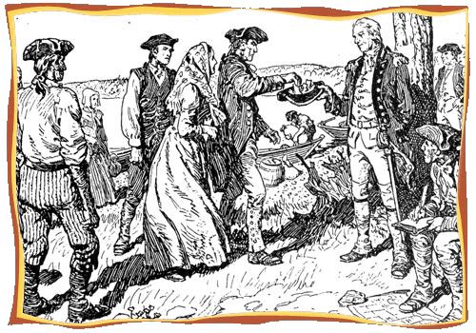
Upper Canada
Loyalists, people of varied ethnic backgrounds, were American colonists who supported the British cause during the American Revolution.
United Empire
Loyalists,
C. W. Jefferys

Slide 5
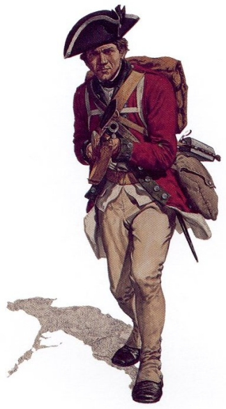
Upper Canada
The Loyalists supported Britain for highly diverse reasons.
Many evinced a personal loyalty to the Crown or a fear that revolution could bring chaos to America.
Many agreed with the rebels that America had suffered wrongs at the hands of Britain, but believed the solution could be worked out within the empire.

Slide 6
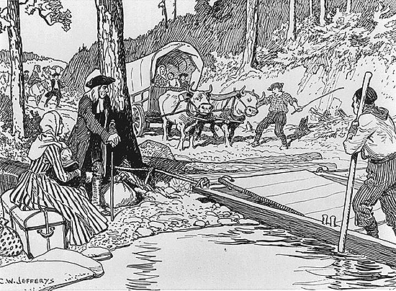
Upper Canada
Following the American Revolution in 1783, approximately 40,000 Loyalists, who were referred to as “Tories” by their fellow countrymen, left the newly created United States.

Slide 7
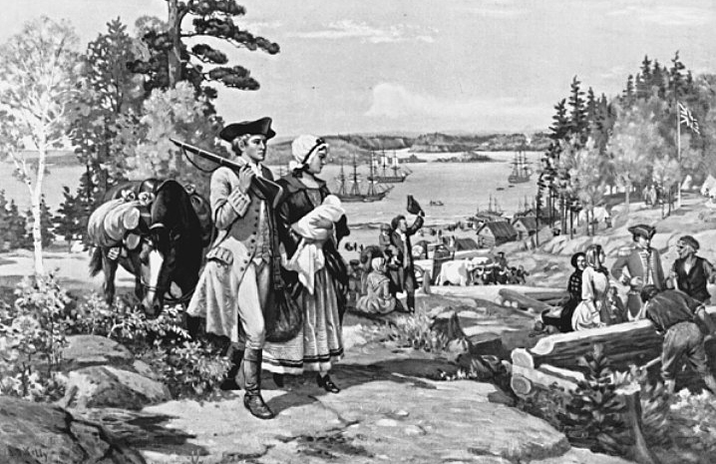
Upper Canada
They started new lives under the British flag in Nova Scotia and in the unsettled lands above the St. Lawrence rapids and north of Lake Ontario.

Slide 8
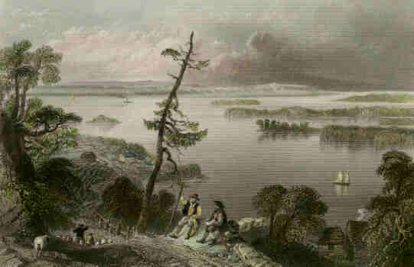
Upper Canada
About 7500 moved into what would become Ontario, most settling along the St Lawrence River to the Bay of Quinte.
Scene of the Bay of Quinte, by
Henry Bartlett,
1842.

Slide 9
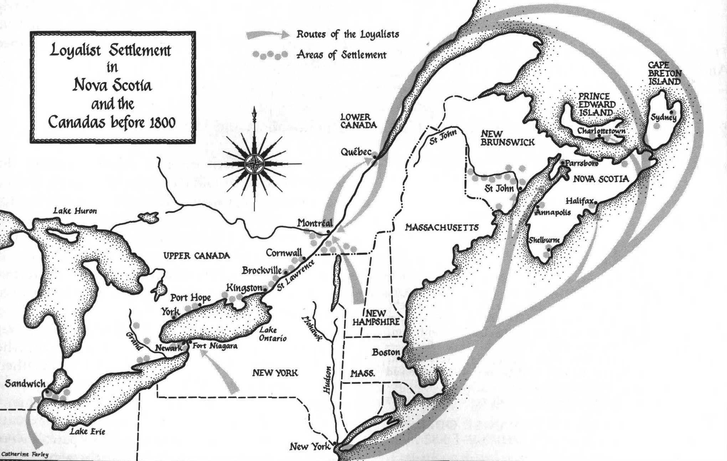
Upper Canada

Slide 10
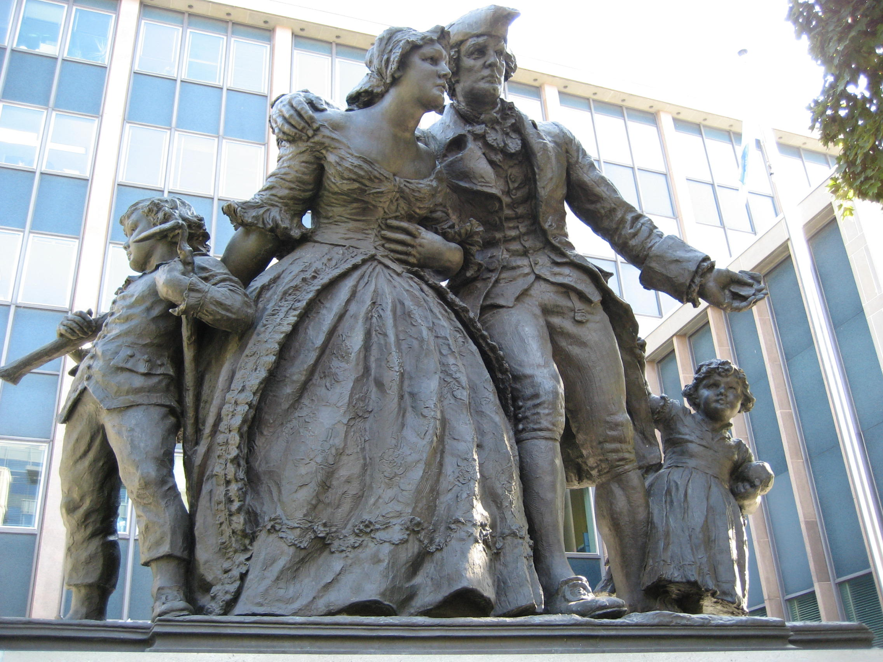
Upper Canada
The Loyalist influx gave the region its first substantial population and led to the creation of a separate province, Upper Canada, in 1791.
United Empire Loyalists statue,
in front of McMaster University, downtown Hamilton, Ontario.

Slide 11
Upper Canada
The American Revolution (1775-1783) created not one country but two. Without the infusion of almost 40,000 American Loyalists into the remaining British North American colonies, what was to become Canada could have offered little resistance to the expansion of the American Republic.
The Loyalist influx gave the region its first substantial population and led to the creation of a separate province, Upper Canada, in 1791.

Slide 12
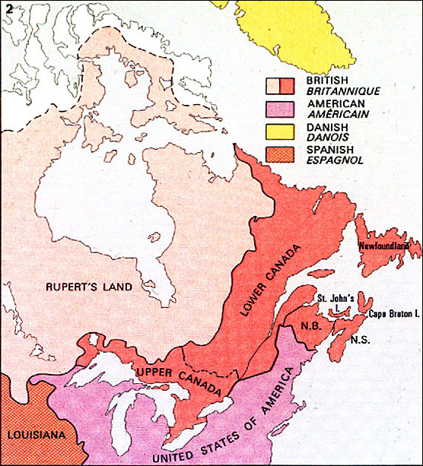
Upper Canada
The Constitutional Act of 1791
was an
Act of the British Parliament that created
Upper Canada and
Lower Canada.

Slide 13
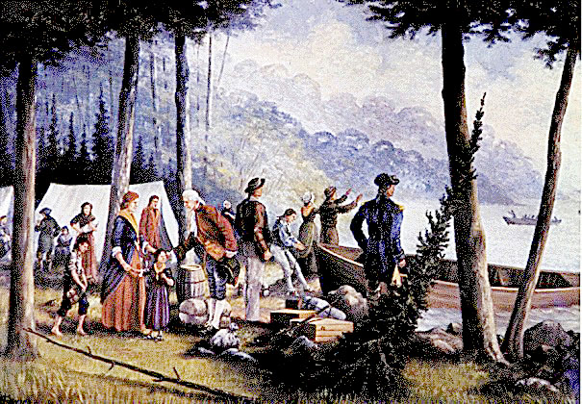
Upper Canada
The reorganization of British North America under the Constitutional Act was a response to the pressure of thousands of Loyalists seeking refuge after the American Revolution.

Slide 14
Upper Canada
The Quebec Act of 1774 was a measure to conciliate the French.
Conditions under that act could not in honour or policy be withdrawn.
Yet the loyalists could not be required to live under French civil and land law and without the representative assembly to which they were accustomed.
One obvious answer was to divide Quebec into separate English and French provinces:
Upper Canada and Lower Canada.

Slide 16
Immigration

Slide 17
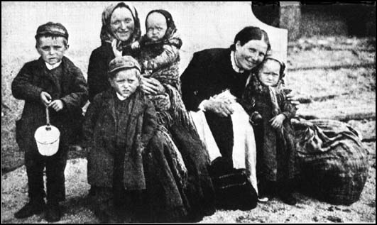
After the War of 1812, a huge wave of people suddenly immigrated to Upper and Lower Canada; no one ever anticipated such a huge number of immigrants.

Slide 18
Major changes in agriculture, manufacturing, mining, transportation, and technology had a profound effect on the socioeconomic and cultural conditions in Britain and throughout Europe.
Many of workers saw their only hope to escape from poverty and unemployment was to go overseas.

Slide 19
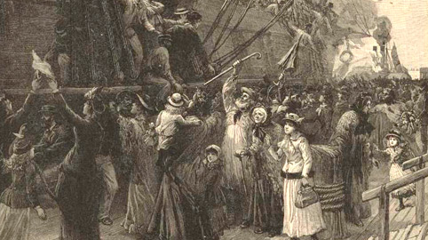
An increasing stream of people was leaving Europe to rebuild their lives in North America. Around 1830, an average of 30,000 immigrants arrived annually in the City of Québec, the main port of entry to Canada.

Slide 20
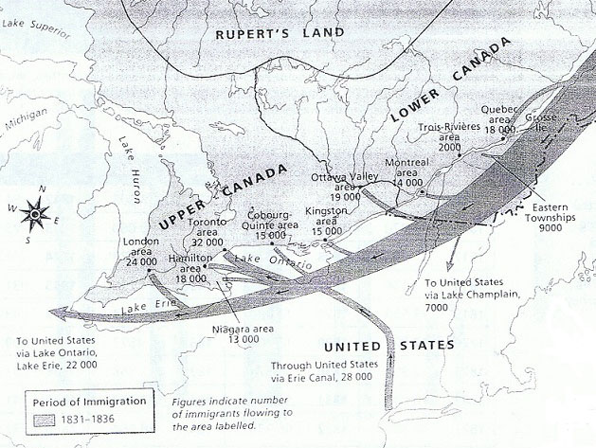
Most of the immigrants settled in Upper Canada.
Some settled in Lower Canada’s Eastern Townships, between Quebec City and Montreal.
By 1831, Quebec was 45% English speaking.

Slide 21
This unprecedented immigration took place at a time when major cholera and smallpox epidemics were sweeping through Europe.
Cholera Bacteria

Slide 22
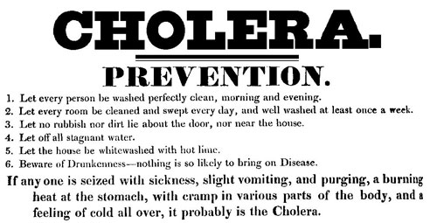
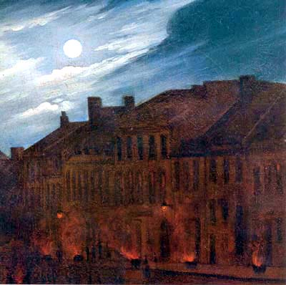
Cholera first reached Canada in 1832, brought by immigrants from Ireland and Britain. Epidemics occurred in 1832, 1834, 1849, 1851, 1852 and 1854. There were cases in Halifax in 1881. The epidemics killed at least 20 000 people in Canada. Cholera was feared because it was deadly and no one understood how it spread or how to treat it.

Slide 23
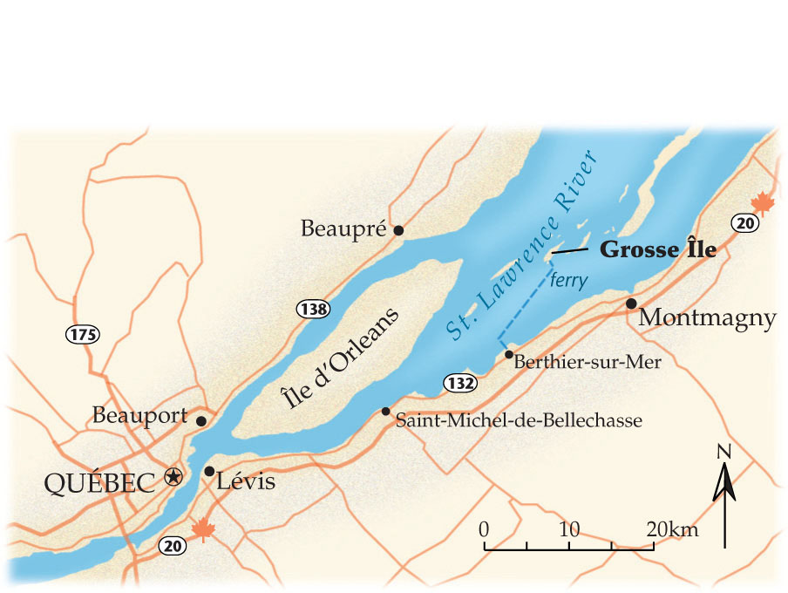
In order to help control the spread of the diseases, the quarantine station at Grosse Île, downstream from the City of Québec, was established in 1832 and operated until its closure in 1937.

Slide 24
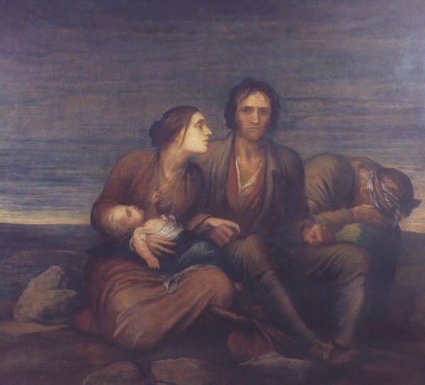
In 1845, the great potato rot in Ireland touched off a mass migration.

Slide 25
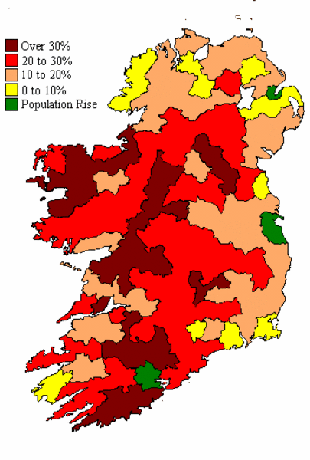
The disaster eliminated the sole subsistence of millions of peasants, thrusting them over the edge of starvation. For five weary years, the crops remained undependable, and famine swept through the land.
Ireland
1841 - 1851

Slide 26
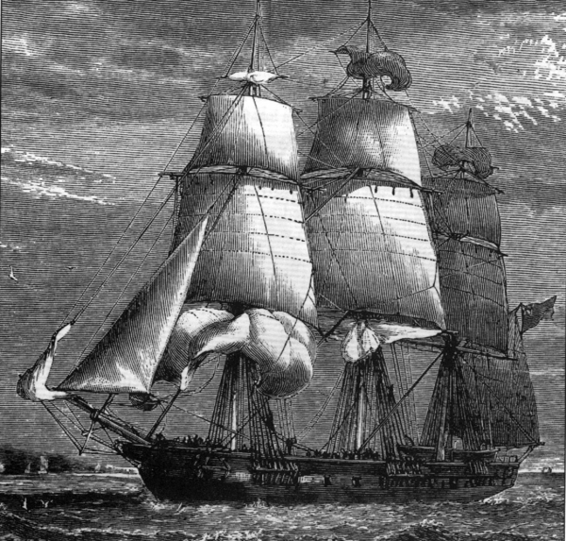
To divert the Irish exodus and help settle Canada, the British offered bargain fares of 15 shillings, instead of 100 shillings. Thousands took advantage and went to Canada on what became known as the "coffin ships" because of their high death rates.

Slide 27
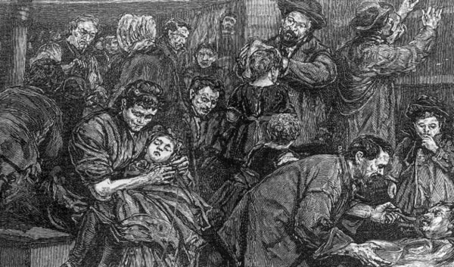
Because few people could afford to travel on decent sailing ships, they travelled in steerage of filthy, overloaded cargo vessels.

Slide 28
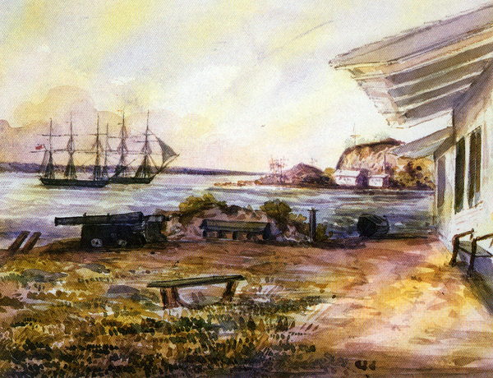
Cargo vessels transported products filled to capacity from North America to Europe, but brought back much less on return voyages.
Quarantined ships at Grosse Île

Slide 29
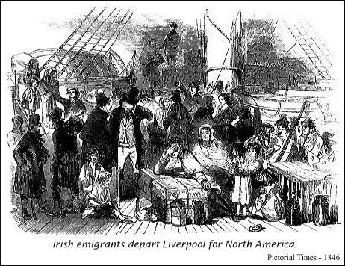
Ship owners quickly realized that there was profit to be made by carrying passengers in the lower decks.

Slide 30
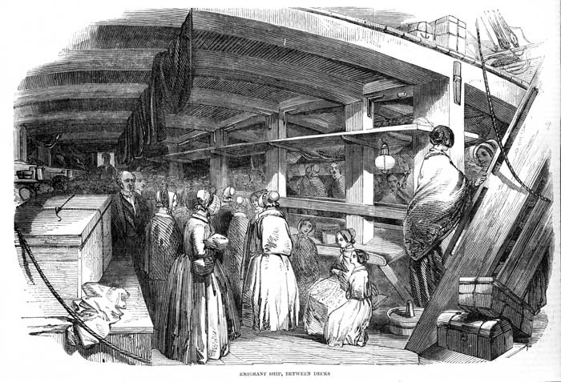
Steerage passengers were forced to live in close quarters, which encouraged the spread of contagious disease.

