Slide 1
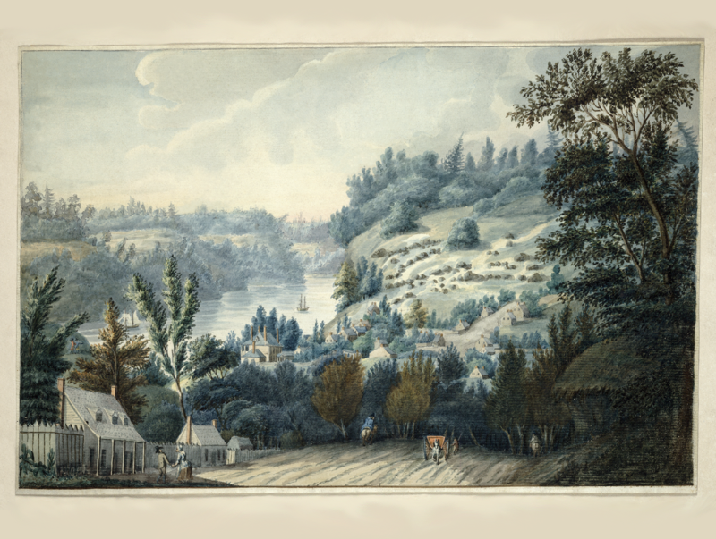
Upper Canada
What was life like in the early 1800s?

Slide 2
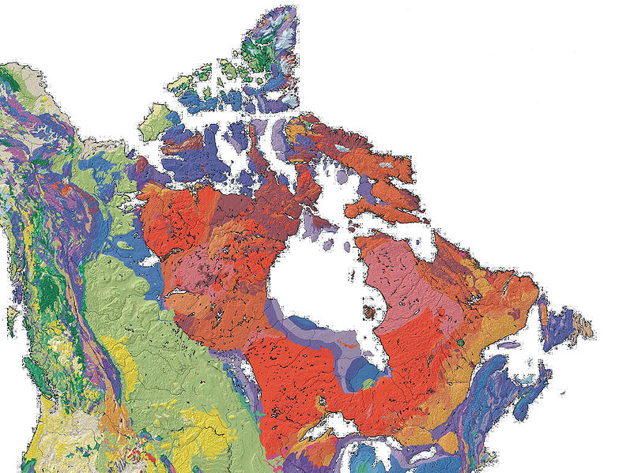
Upper Canada
The Canadian Shield
The Canadian Shield (pictured in shades of red) is Canada’s largest physiographic area.

Slide 3
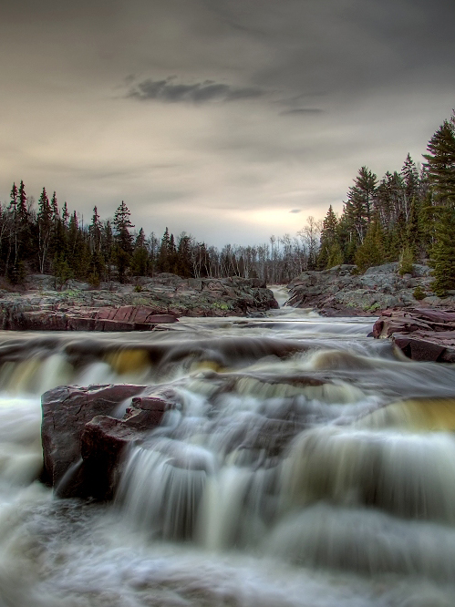
Upper Canada
The rocks are exposed or are covered by soils, peat, sand, gravel, clay and debris from the glacial activity in the past.
Not good for agriculture.
Good for mining and forestry.
Good for fur trade.

Slide 4
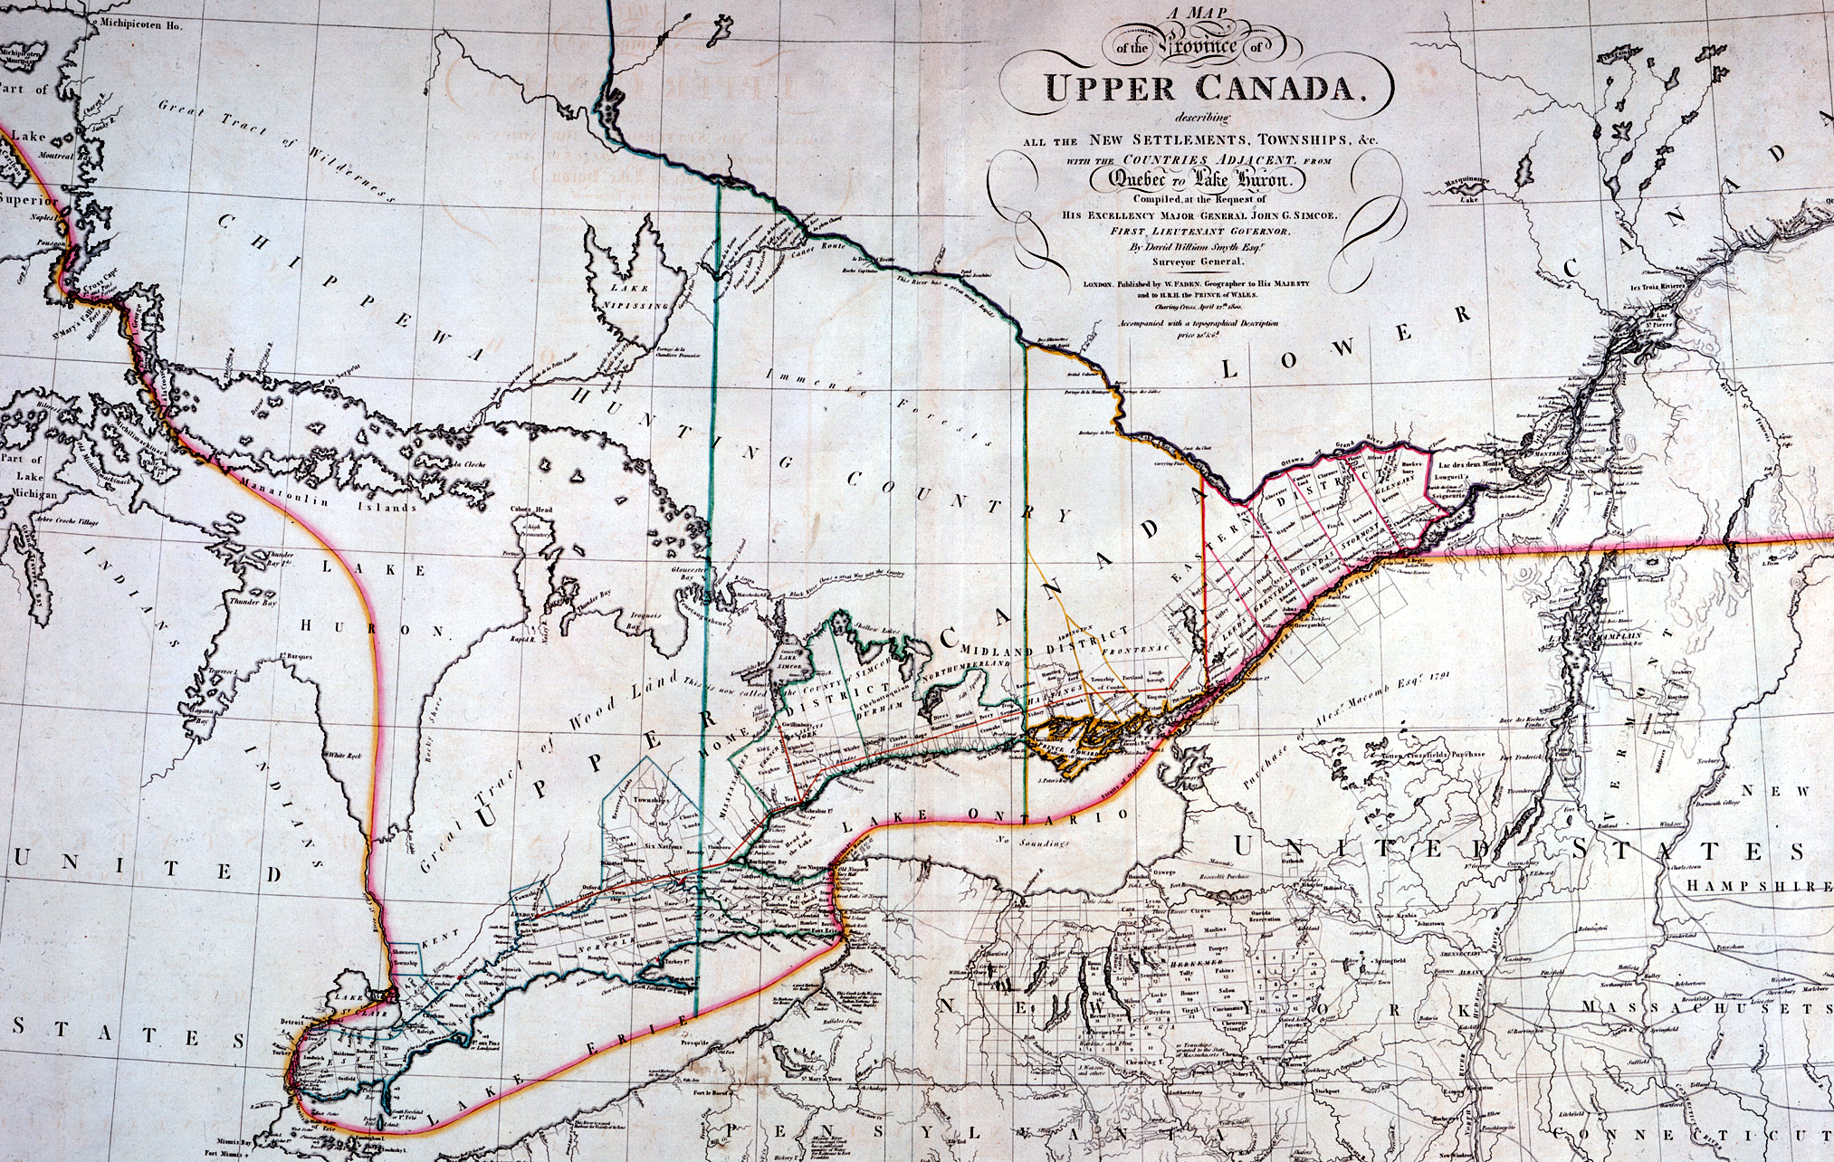
Upper Canada

Slide 5
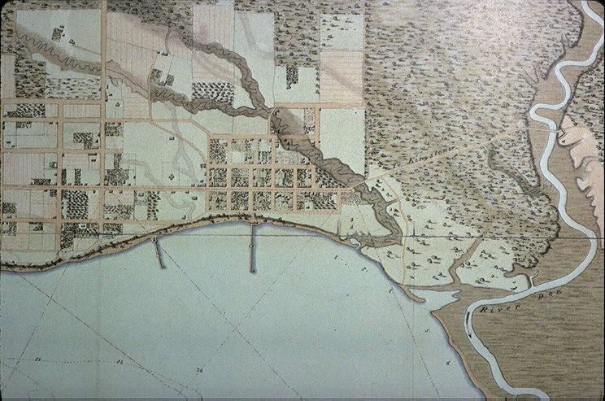
Street Plan of York, circa 1818
Places at a distance of 30 or 40 kilometres from York, the capital of Upper Canada, were considered remote.

Slide 6
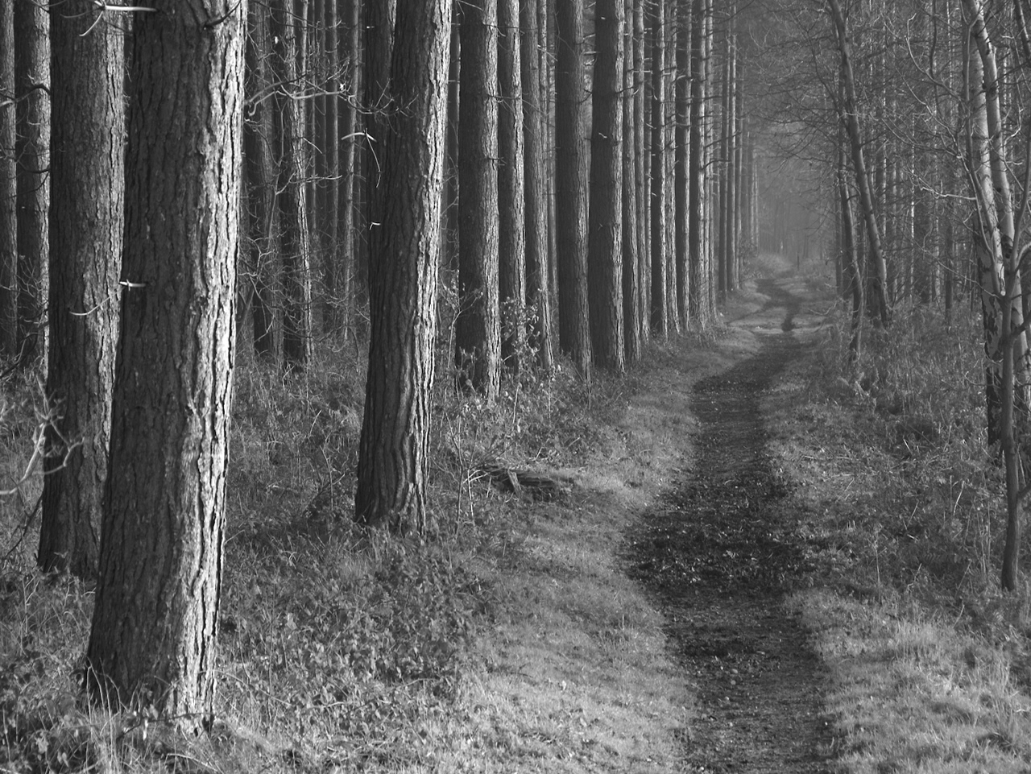
There were few roads; even the military routes – Yonge and Dundas – were just tracks through the woods.

Slide 7
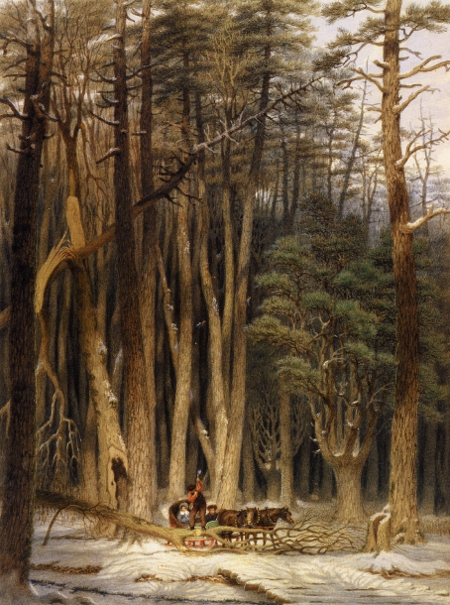
The roads were poor; travel was difficult.

Slide 8
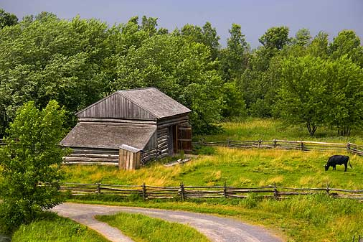
It was quiet.

Slide 9
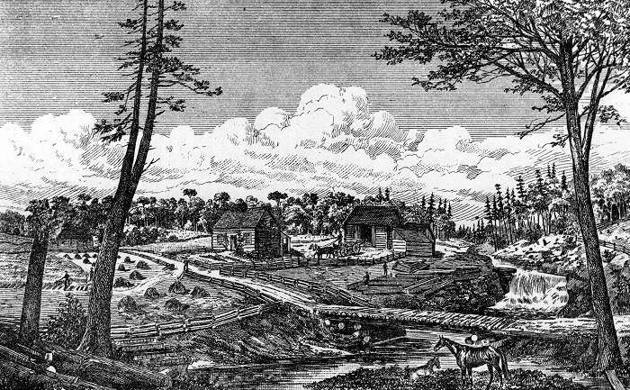
Cities have constant background noise to which we have grown accustomed. For pioneers in Upper Canada, a steam-powered sawmill would have been considered loud.

Slide 10
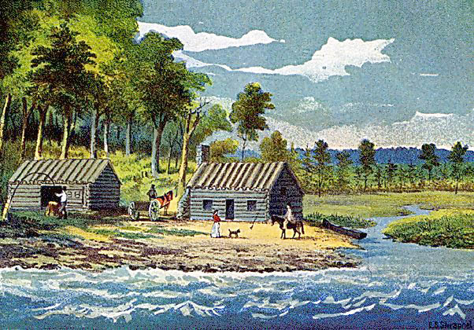
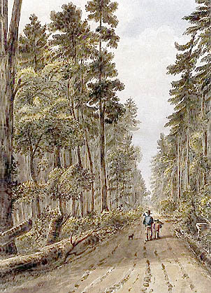
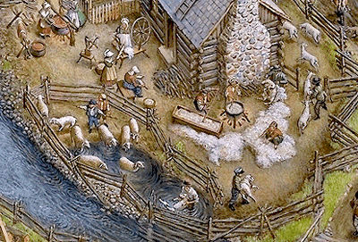
Clearing land was a huge task.

Slide 11
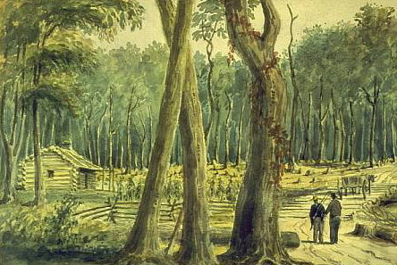
No more than one hectare could be cleared
in one year.

Slide 12
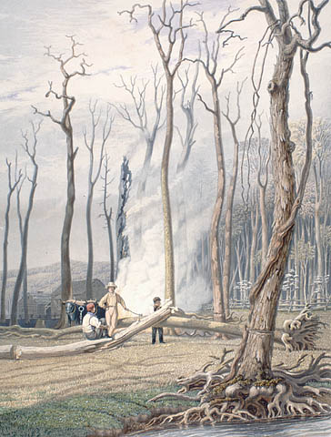
It would take a family 20 or more years to clear a 25- hectare farm, which is a little larger than a city block.

Slide 13
It took years to raise a crop that would not be entirely consumed by the family or sold to pay off debt.
Most people were in debt at some time to merchants, and mortgaged their next crop to obtain supplies.

Slide 14
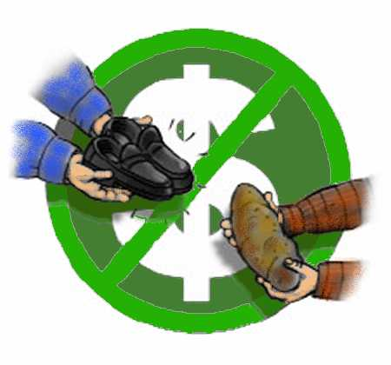
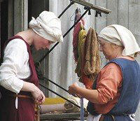
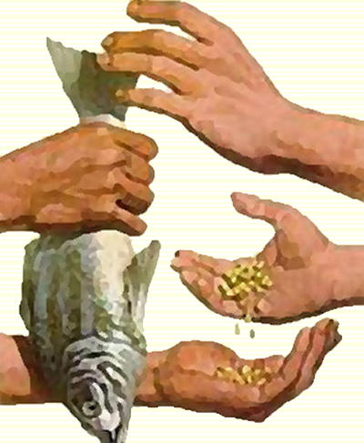
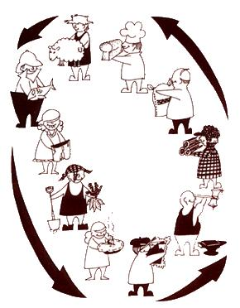
The economy of Upper Canada consisted largely of trading products and services.
Barter Economy

Slide 15
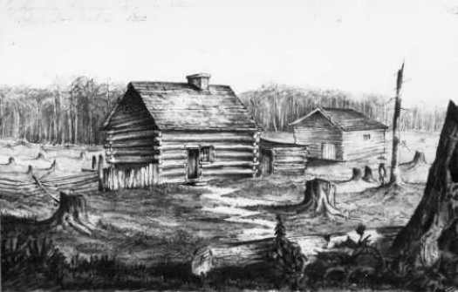
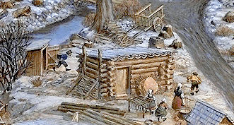
In the early 1800s, many aristocrats and pensioned-off army officers settled in Upper Canada.
They were dismayed to find that they had to do back-breaking labour themselves because cheap, reliable workers were scarce.

Slide 16
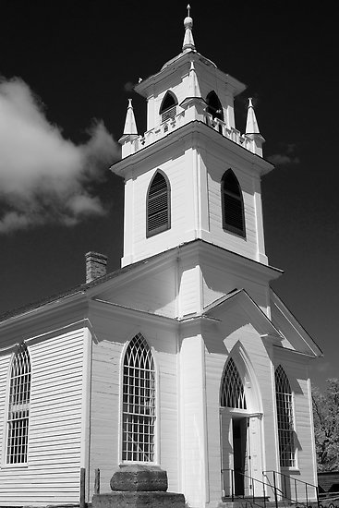
People looked forward to church, which was very much a social event.
The Anglican Church was the predominant church in Upper Canada.

Slide 17
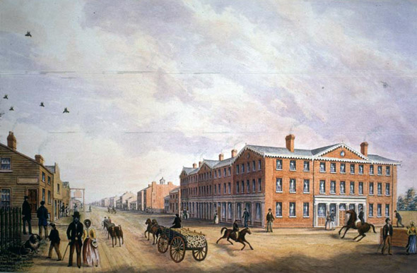
The Importance of Social Class
Social class and financial means usually determined what kind of life an immigrant would experience in Upper Canada.
On March 6, 1834, York was incorporated as the City of Toronto.

Slide 18
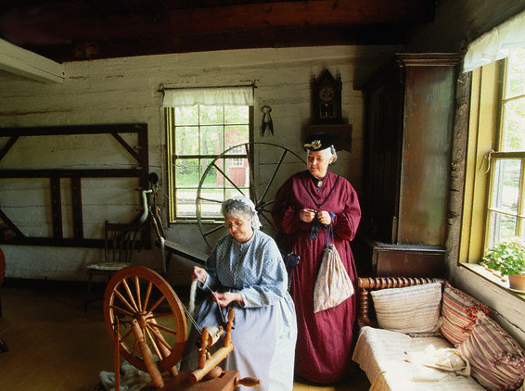
Women in Upper Canada defined themselves mainly according to their social class.

Slide 19
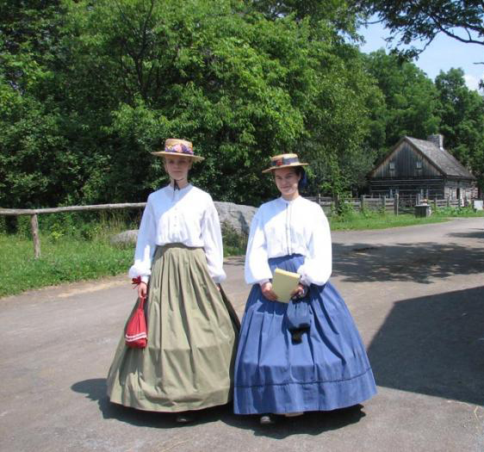
Like men, their expectations, lifestyle, prejudices, and beliefs depended on the class to which they belonged.
They viewed their own success or failure in terms of the successes or failures of their fathers and husbands.

Slide 20
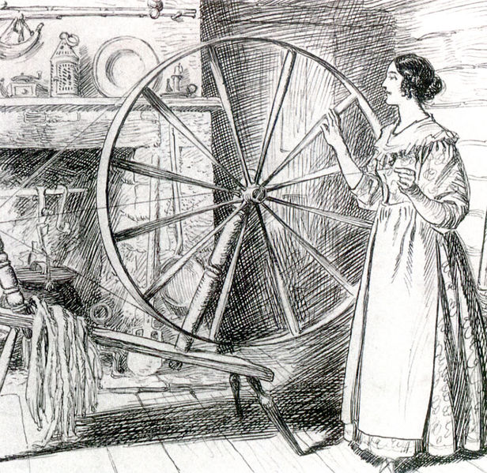
Most women of marriageable age were married, less for romantic love than for the proper match.
Spinsters, or unmarried women, were pitied, and had to rely on relatives for support or a place to live.

Slide 21
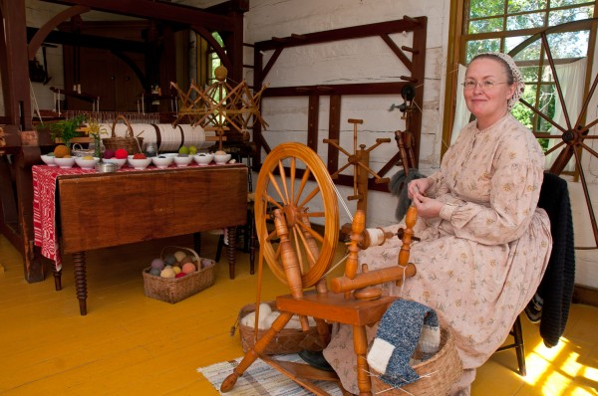
Upper-class women were active in developing and running farms, usually depending on help from lower-class women.
Poor immigrant women had to work long hours doing all the household work, planting and harvesting.

Slide 22
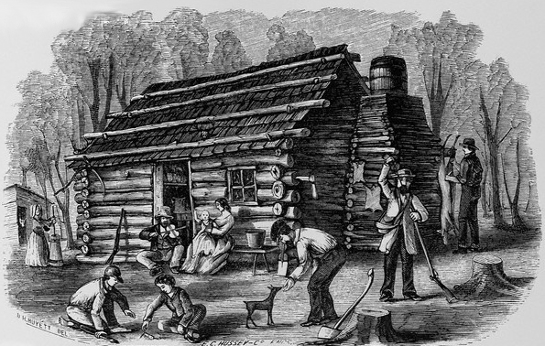
All pioneer women were expected to have large families.
In rural society, children were expected to contribute to the household as soon as they were able.

Slide 23
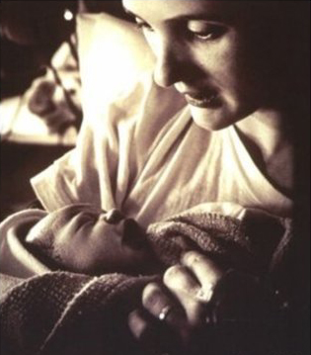
Childbirth was hazardous for all women because of the lack of medical care and little knowledge about proper hygiene.
For poor women, the risks were greater because they could not afford the midwives or servants hired by the upper classes.

Slide 24
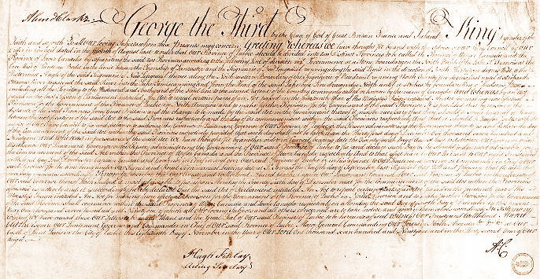
Colonial Government
The Constitutional Act of 1791 was a clear response by London to the American Revolution.
The excess of democracy that had flourished the southern colonies would not be allowed in the two new provinces of Upper and Lower Canada.

Slide 25
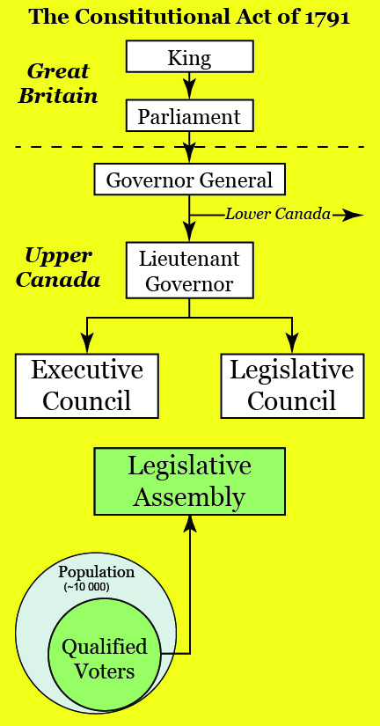
Colonial Government
A lieutenant-governor was established in each province with
an executive council to advise him,
a legislative council to act as an upper house, and
an elected legislative assembly.
Policy was to be directed by the executive, which was responsible not to the assembly, but to the Crown.

Slide 26
Land Reserves
Clergy Reserves
In Upper Canada, funds were generated "for the Support and Maintenance of a Protestant clergy” by the establishment of one-seventh of all lands in the province as reserves, with the proceeds from sale or rental going to the church.

Slide 27
Land Reserves
The phrase "a Protestant clergy" was interpreted to mean the Church of England.
In Upper Canada, where the majority of the population belonged to other denominations than the Church of England this interpretation caused trouble from an early date.

Slide 28
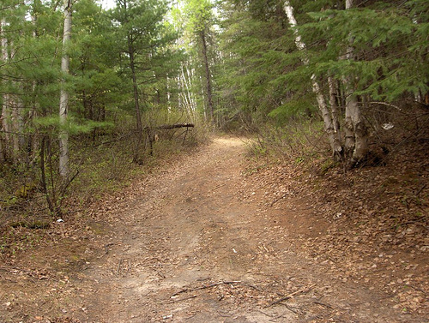
Land Reserves
Crown Reserves
Another one-seventh of the land, known as crown reserves, was allocated to generate revenue to pay the costs of the provincial administration.

Slide 29
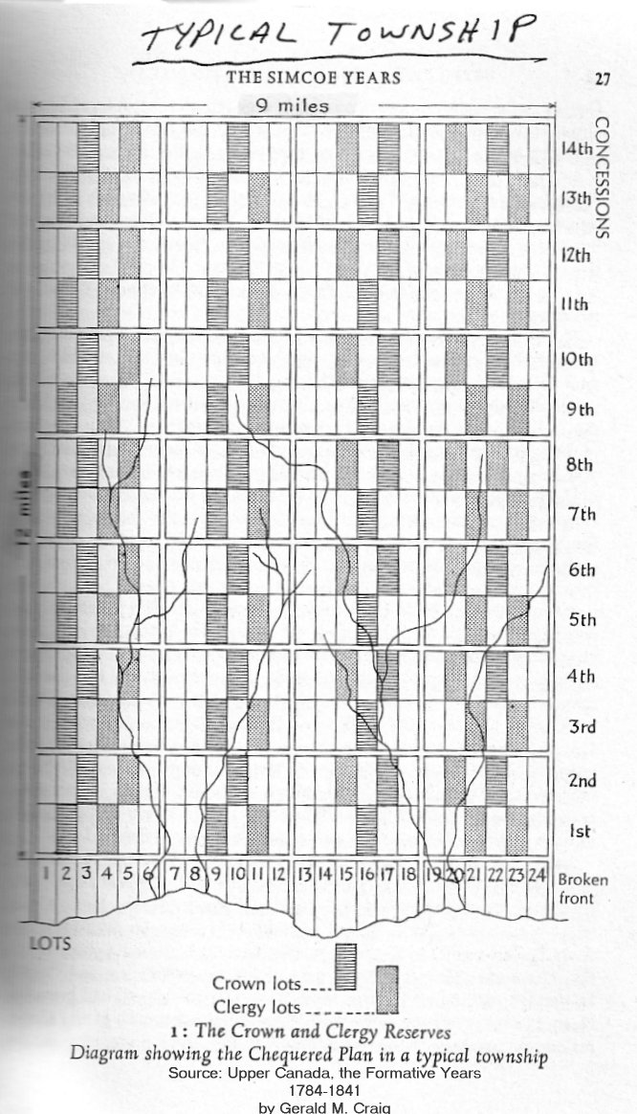
Crown and Clergy Land Reserves
This method of allotting reserves kept discontinuous plots out of cultivation and prevented settlement and the expansion of roads.

Slide 30
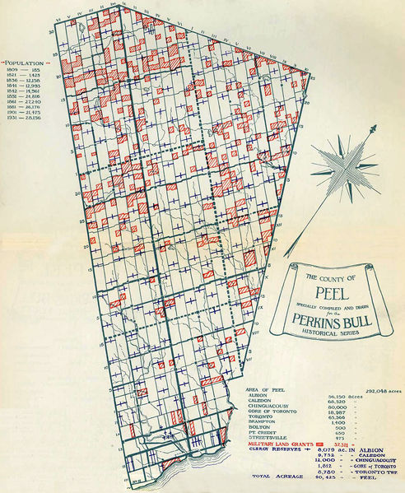
Crown and Clergy Land Reserves

