Slide 1
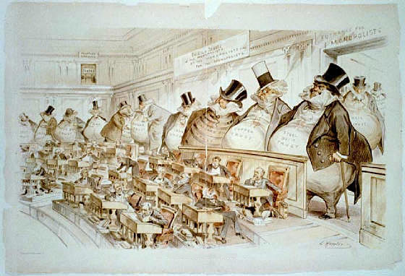
Colonial Oligarchy:
The Family Compact

Slide 2
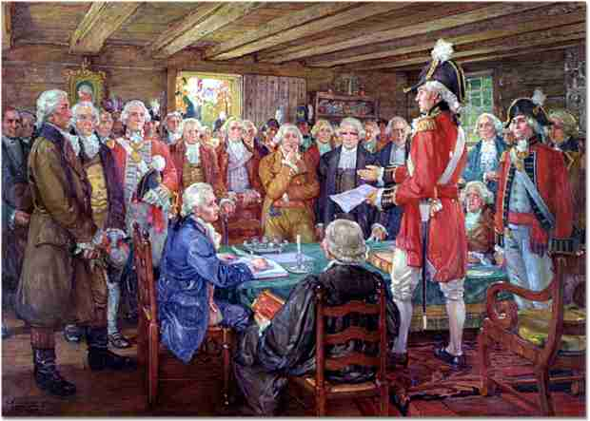
Colonial Oligarchy
The Family Compact was an exclusive, closed oligarchy of wealthy, Anglican, conservative, elite landowners, administrators, churchmen and businessmen.
The group was centred in Toronto, then called York.

Slide 3
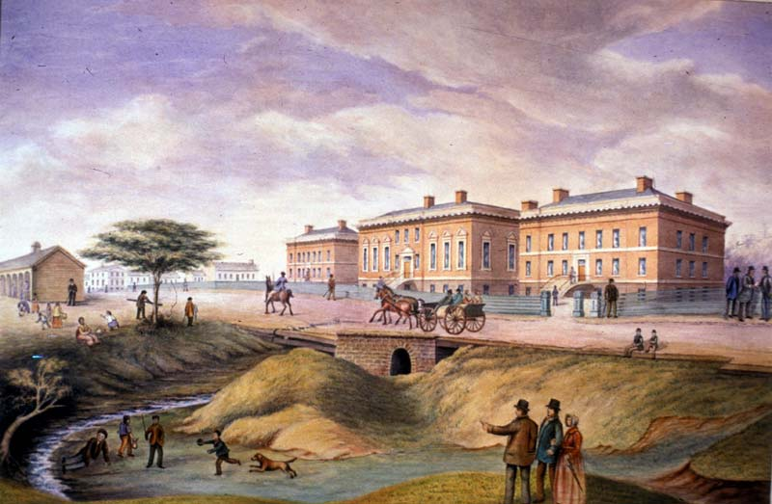
The Family Compact
The Family Compact, some of whose members belonged to the same family,
Had a virtual monopoly of political office, and…
Parliament
Buildings,
York, 1832

Slide 4
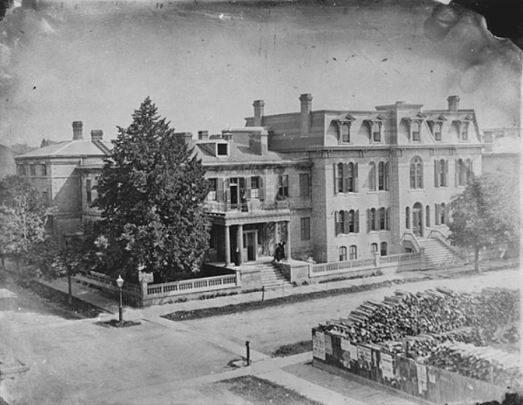
The Family Compact
Strongly influenced
banking,
education,
the issuing of land grants,
the affairs of the Anglican church in Canada, and
the courts.
Bank of Upper Canada

Slide 5
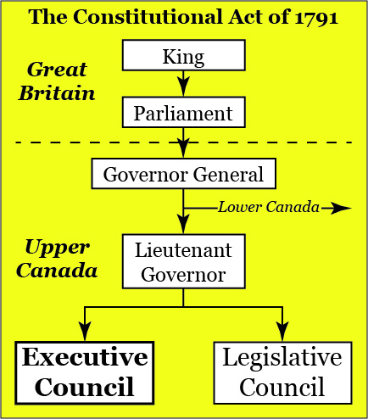
The Family Compact
They controlled the legislative and executive councils of the government.
The executive council was appointed by the Governor of the colony.

Slide 6
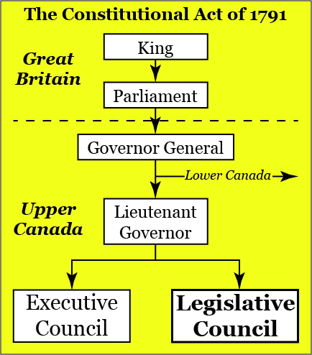
The Family Compact
The Legislative Council had to consist of at least seven members.
Members were appointed for life but could be dropped for non- attendance.

Slide 7
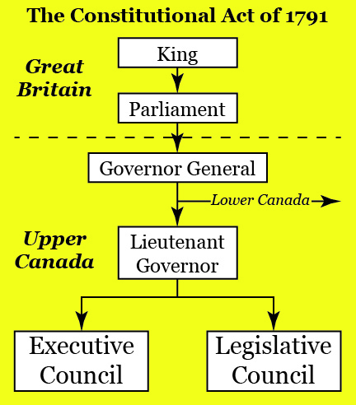
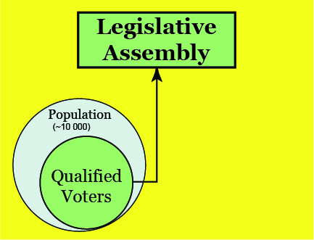
The Family Compact
The Constitutional Act seemed on the surface a very liberal measure.
It gave the people of Upper Canada a Legislative Assembly elected on a wide basis.
But what it gave with one hand, it took away with the other.

Slide 8
What is a Representative Government?
A government in which representatives are elected by people to make laws on their behalf.
What is a Responsible Government?
A government that can be voted out of office if elected representatives fail to please the majority of people who elected them.
What is a Democratic Government?
One which is usually both representative and responsible.

Slide 9
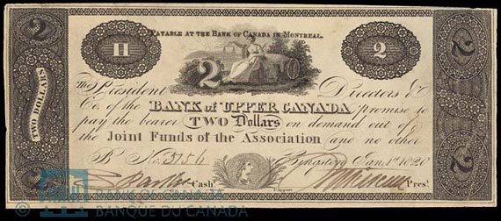
The Family Compact
The legislature was elected from the general eligible voters, who were male and land-owners.
However, through pressure, blackmail, bribery and other methods, the Family Compact insured that it was their people who were elected, and the executive council also threw their support behind the compact candidates.

Slide 10
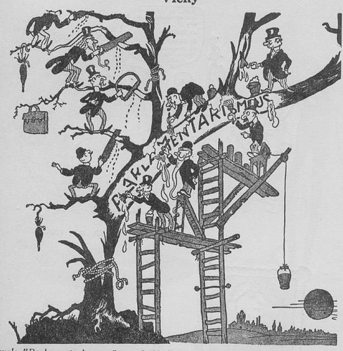
The Family Compact
The work of creating and passing legislation was placed partly in the control of the lieutenant- governor and his advisers.
The Legislative Council was an upper house which could block any measures passed by the Legislative Assembly.
The Legislative Assembly was, in effect, powerless.

Slide 11
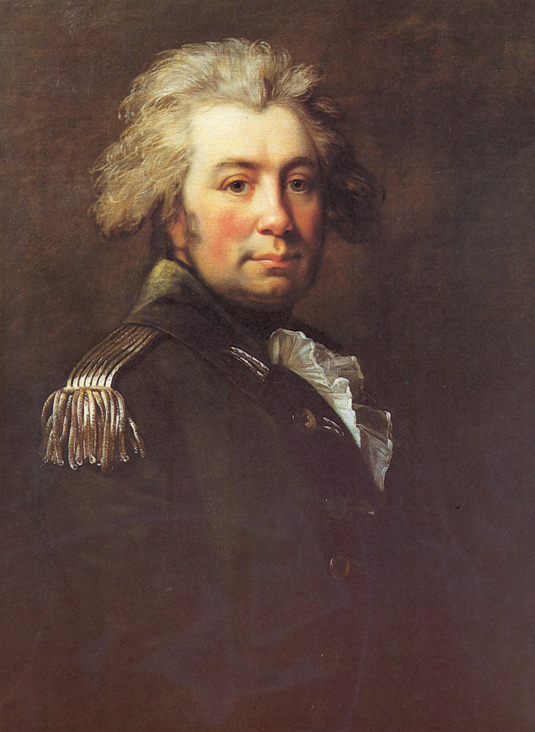
The Family Compact
The group emerged after John Graves Simcoe, Upper Canada's first lieutenant-governor (1791-1796), attempted to create a local aristocracy by appointing his Loyalist friends to government posts and granting them land.
John Graves Simcoe
Lt. Governor 1791-1796

Slide 12
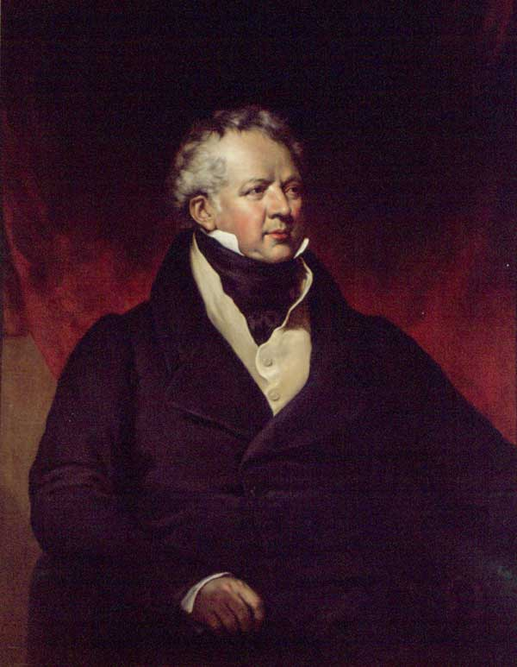
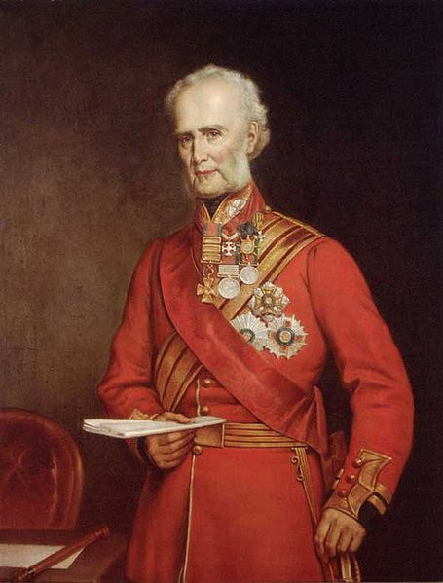
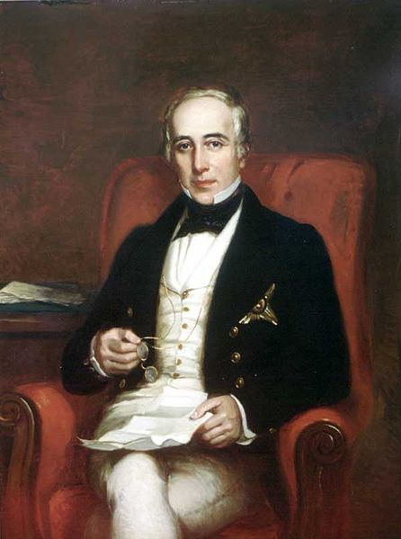
The Family Compact
Lieutenant-governors that followed Simcoe chose their executive and legislative councils from men they could trust and understand, who shared their solid, conservative values:
Descendants of United Empire Loyalists or
recent upper-class British settlers.

Slide 13
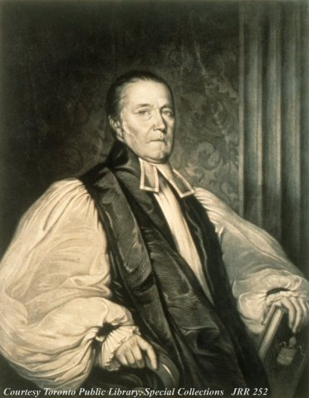
The Family Compact
Although never a Lieutenant-Governor, one of the most prominent and influential members of the Family Compact was Bishop John Strachan.
He was appointed to the Executive Council and served as an advisor to the Lieutenant Governor.

Slide 14
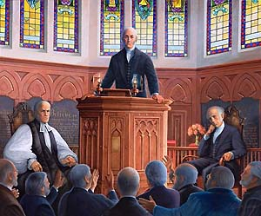
The Family Compact
Under the leadership of Strachan, the members of the Family Compact were
strong royalists,
anti-Republican, and
supporters of the Church of England over not only Catholicism but other Protestant churches.
They especially interpreted the Constitutional Act of 1791, which gave land grants to build Protestant churches, to refer to Anglican churches alone.

Slide 15
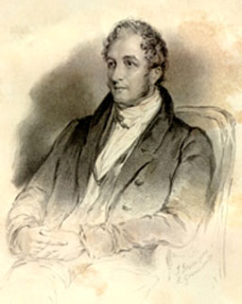
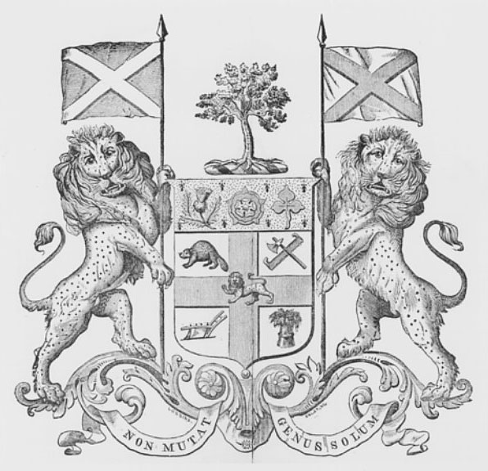
The Family Compact
The Canada Company was established in late 1824 and chartered in 1825 by John Galt as a land and colonization company in Upper Canada.
John Galt
As settlement began to spread further into the colony the government sold a lot of land to the Canada Company.
Canada Company Coat of Arms

Slide 16
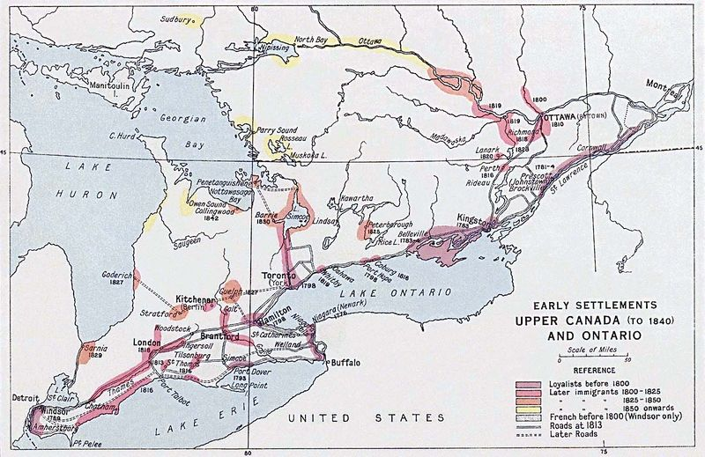
The Family Compact
In 1826 the company purchased from the government about 2.5 million acres (1 million ha) of land for $295 000.
Then the land was sold to settlers and farmers.

Slide 17
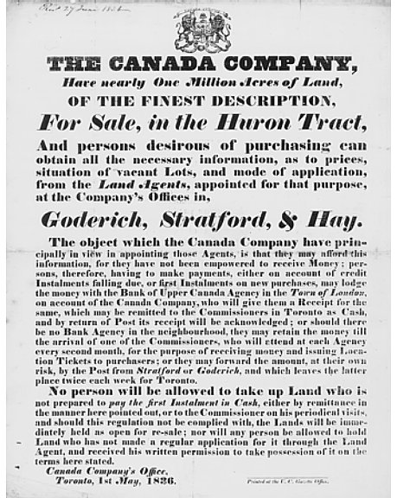
The Family Compact
Over time, the Canada Company developed a reputation for mismanagement and corruption, and its close alliance with the Family Compact.
The members of the Family Compact made a great deal of money on land speculation and kept the best land for themselves.

Slide 18
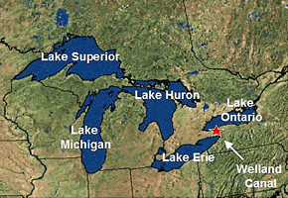
The Family Compact
The Family Compact used public funds to benefit themselves.
They improved roads and constructed canals in areas where they had farms, businesses and factories.
The Welland Canal was one such project, which created a lifeline of trade into the heart of North America.

Slide 19
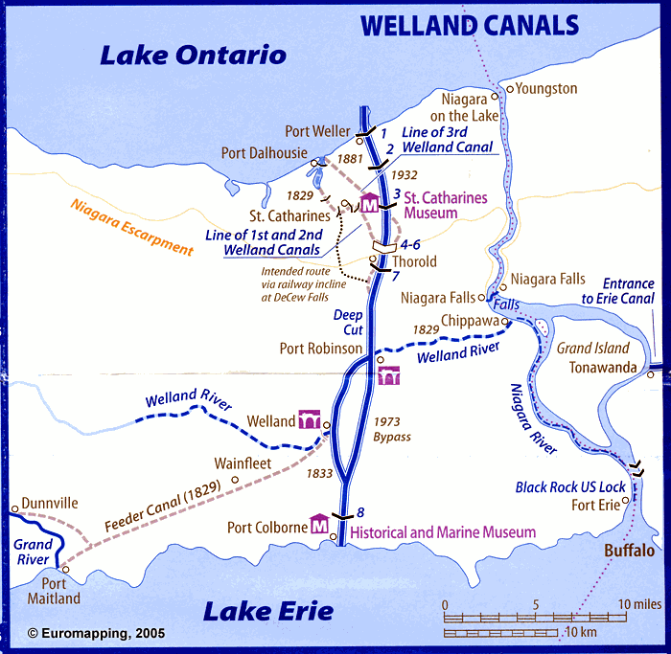
The Family Compact

Slide 20
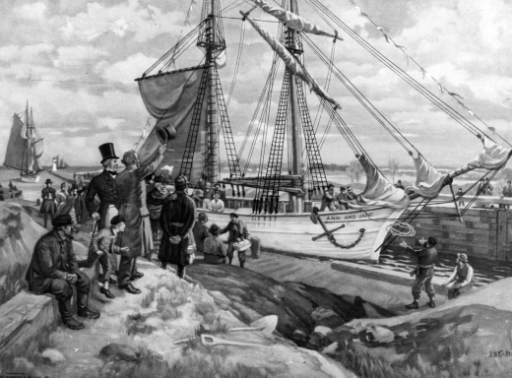
The Family Compact
The first Welland Canal opened in 1829.

Slide 21
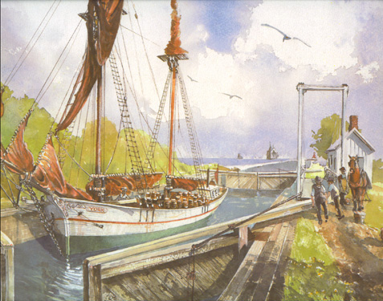
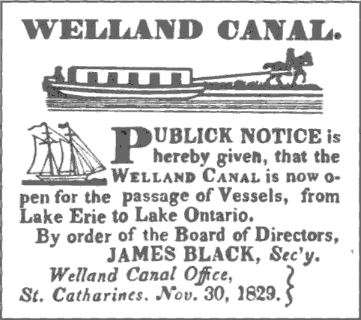
The Family Compact
This achievement is attributed to a St. Catharines businessman, William Hamilton Merritt.

Slide 22
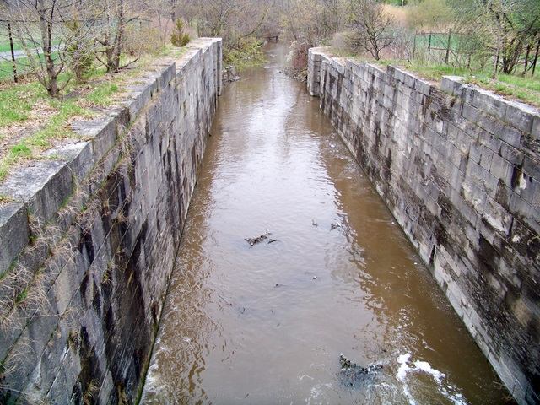
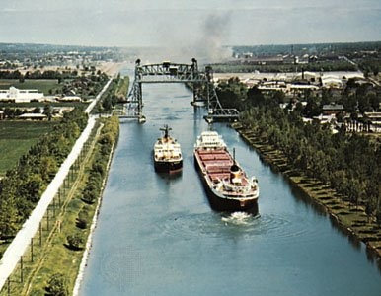
The Family Compact
The idea arose from his plan to connect the water of the Welland River to Twelve Mile Creek to provide water for his grist mills.
Welland Canal today.
Welland Canal lock, built in 1820s.

